Slide 1
Vehicle Services Division
County Officials Orientation Program 2022

Slide 2
Welcome!
  OVERVIEW OF the TN Dept. of Revenue
  About Vehicle Services
  How each VS work unit works with the counties

Slide 3
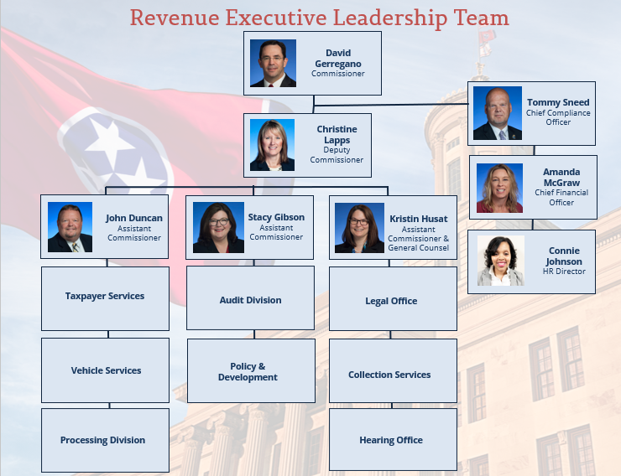
About TN Dept. of Revenue
As Tennessee’s chief tax collector, Revenue (DOR) is responsible for the administration of state tax laws and motor vehicle title and registration laws established by the legislature and the collection of taxes and fees associated with those laws.

Slide 4
About Vehicle Services
Vehicle Title & Registration is administered by the Tennessee Department of Revenue through its Vehicle Services Division. Working in concert with the Department of Revenue's Vehicle Services Division, County Clerks in each of Tennessee's 95 counties across the state register vehicles and assist with title transactions. Serving as deputy registrars and agents of the State, County Clerks share responsibility for administering Tennessee's motor vehicle title and registration laws.
County Clerks ensure all vehicles operating on the road are properly titled and registered and hold the important responsibility of collecting appropriate sales tax and other fees and taxes related to motor vehicles.

Slide 5
Introduction to Vehicle Services
We are …
  A division within the Department of Revenue.
  Vehicle Services registered 7,875,717 vehicles which represents $359 million in revenue for the 20-21 fiscal year.*
  Our mission is to offer the highest quality of customer service with respect, courtesy and individual professionalism.
  The Vehicle Services team pledges to provide accurate and timely vehicle title, registration and tax information to each customer in the most efficient manner.
  *2020-2021 TN DOR Annual Report
Notes:
Vehicle Services is part of the Department of Revenue. The Department of Revenue is responsible for collection of taxes based on various laws. Revenue collects around 87% of the state’s revenue. Vehicle Services is part of the Department of Revenue because we collect registration fees. In the last fiscal year, Vehicle Services brought in $327,530,123.64 through registrations and registered 7,681,922 vehicles.
Commission Gerregano explains because state government uses tax dollars, collected through vehicle title and registration, to fund and provide the services that Tennessee residents rely upon, it is essential that we provide etiquette and excellent customer service our customers.
Customer service is the State and Vehicle Services’ mission. We want our customers, taxpayers, to know we’re here to help and guide them through their issues/problems. Whenever possible, educating the customer is the priority. As a representative of the state, provide customers accurate and timely information to build trust. These are important factors because great customer service is noticed. Nissan, Amazon, and Volkswagen all are in Tennessee – why? These companies want states that are good to work with, and great customer service is a part of this.

Slide 6
LINKS
County Clerk Guide
https://tnclerks.zendesk.com
Department of Revenue’s website
https://www.tn.gov/revenue/
VTRS Web Inquiry
https://vehiclelookup.revenue.tn.gov/#/login
Revenue’s Annual Report
https://www.tn.gov/content/dam/tn/revenue/documents/pubs/annual_report2021.pdf
About the Dept. of Revenue (video)
https://www.youtube.com/watch?v=bBdSw4Y0vRo&t=17s
Legislative Summaries
https://www.tn.gov/revenue/tax-resources/legal-resources/legislative-summaries.html
Online Law Book
http://www.lexisnexis.com/hottopics/tncode/

Slide 7
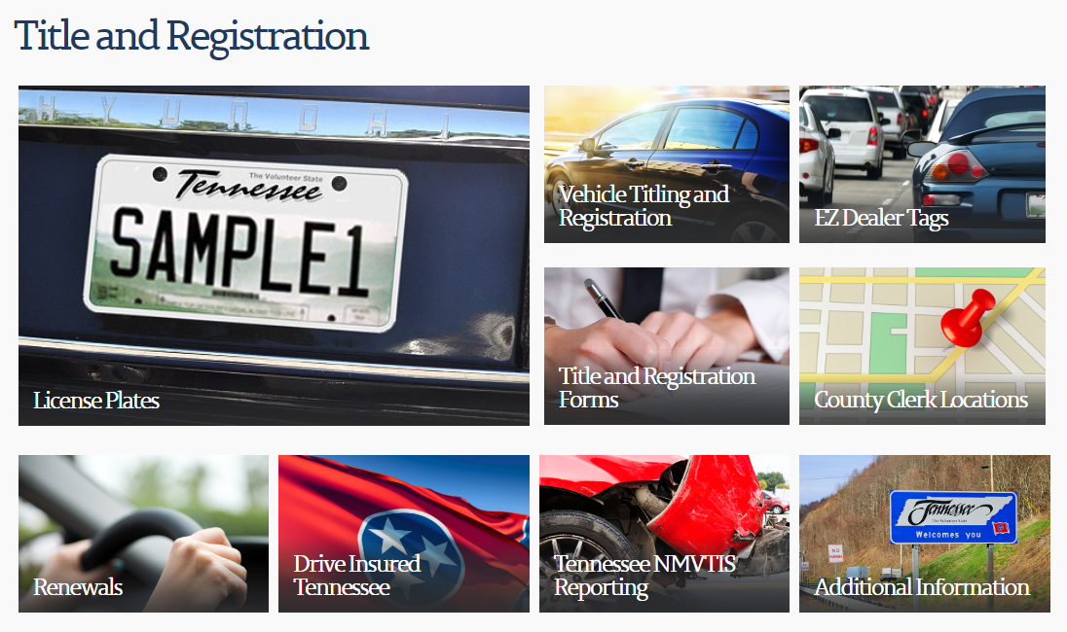
About Vehicle Services – Communications
Title & Registration Website
www.tn.gov/revenue

Slide 8
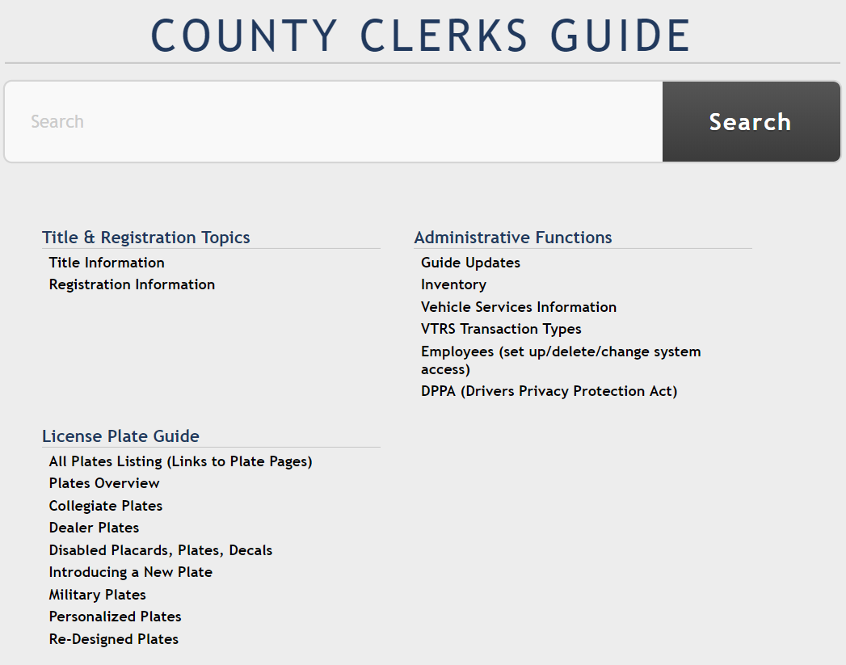
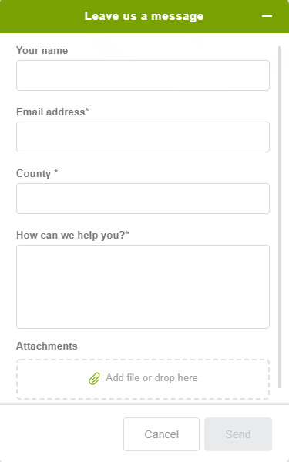

About Vehicle Services – Communications
County Clerk Guide
https://tnclerks.zendesk.com/hc/en-us

Slide 9
Introduction to Vehicle Services
Call Center & Research
  Call Center responds to calls from the public and 95 county clerks regarding vehicle titling and registration. They also issue and correct titles, as well as remove stops called in by the county clerk offices.
  NCIC (National Crime Information Center) terminal which supports law enforcement and state agencies in the recovery of stolen vehicles.
  NMVTIS (National Motor Vehicle Title Information System) helpdesk that responds to questions regarding NMVTS, which Tennessee joined September 2020. NMVTIS offers state and customer information regarding vehicle title history, odometer, and brand history.
  Research processes Abandoned Vehicle requests, Vehicle Information Requests and mobile home de-titles.
Notes:
The Call Center & Research is comprised of a call center, NCIC, the National Crime Information Center, NMVTIS – National Motor Vehicle Title system and Research. The call center responds to inquiries from both the public and the 95 county clerks and can handle approximately 700 calls daily and 3,500 per week. On average, the call center handles about 14,000 calls per month. Not only are representative responsible for responding to phone calls, and they also correct title & registration issues. They can issue & correct titles and clear stops on the system when called in by the county clerk.

Slide 10
Introduction to Vehicle Services
County Clerk Support
  Liaisons between the State and 95 county clerks.
  Informs clerks on recent legislative decisions, updates forms and letters.
  Updates and edits the County Clerk Guide and website.
  Supports dealers with EZ Dealer Tags.
  Responds to county clerk emails, Zendesk tickets and phone calls.
  Assists the Inventory Unit with license plate order requests.
Notes:
County Clerk Support bridges the gap between the State and our 95 county clerks. They inform the counties of recent legislative decisions and alert them of updates to existing forms and letters. County Clerk Support updates and edits the County Clerk Guide and the Revenue website. Additionally, they support dealers who participate in the EZ Dealer Tag program. This program allows electronic submission of paperwork related to a vehicle transaction from dealer to county clerks and provide the customer temporary tags.

Slide 11
Introduction to Vehicle Services
Inventory & Specialized Application Unit
  Inventory Unit
    Begins plate production and completes order requests for county clerk’s controlled and non-controlled stock.
    Handles license plate order requests.
    Handles drive out tags.
  Specialized Application Unit (SAT)
    Processes title and/or registration applications for specific companies and special groups (government service agencies.)
    Discharges liens
Notes:
The Inventory & SAT Unit are two units in one. The Inventory portion is responsible for everything license plates. They oversee plate production from beginning to end, fulfill county clerk plate orders and complete personalized plate requests. The Inventory unit also handles drive out tags issued by dealers to their customers for vehicle purchases, as well as controlled and non-controlled stock for county clerks. The SAT Unit, or Specialized Application Unit, processes title and/or registration applications for specific companies and government service agencies and discharge liens. The variety of tasks provided by this unit makes it clear why they’re called a specialized application unit.

Slide 12
Introduction to Vehicle Services
TNState Unit
  Processes title applications which are sent into the State in an incomplete status, by the county clerk.
  Processes applications which were previously rejected for additional information.
  Issues titles not processed by either county clerk or call center.
  Processes second noting of liens.
Notes:
The TN State unit processes transactions that are incomplete or previously rejected and RO, which are Registration Only transactions. All transactions are completed from a work grid through the TN State system. This unit issues titles that were not processed by either the county clerk or call center. Last, this unit processes second noting of liens; first noting of liens is done by the county clerks.

Slide 13
Introduction to Vehicle Services
Rebuilt & Salvage Support Unit
  Also known as Anti-Theft.
  Processes salvage, non-repairable and rebuilt title applications.
  Collaborates with Special Investigations (SI) to inspect rebuilt vehicles from dealers and general public.
  Processes county clerk transactions which require review for salvage/rebuilt process.
  Completes requests for replacement VINs and TN VINs.
  Responds to Zendesk questions and phone calls.
Notes:
Rebuilt & Salvage Support Unit processes title applications for vehicles identified as salvage, non-repairable or rebuilt. By law, any vehicle that is less than 10 model years old that has sustained damage of 75% or more than the retail value of the vehicle must undergo this process before the vehicle can be driven again. Vehicles with non-repairable titles are unable to be driven on the road and can only be used for parts. Formerly known as Anti-Theft, this unit collaborates with Special Investigations (SI) in the inspection of rebuilt vehicles from the public and/or dealers. They also complete requests for replacement VINs and TNVINs. This unit communicates with customers via Zendesk questions and phone calls.

Slide 14
Introduction to Vehicle Services
Electronic Insurance Verification System (EIVS)
  Established in January 2017 in response to the James Lee Atwood Jr. law.
  Created to help reduce the number of uninsured drivers in the state of Tennessee.
  Collaborates with all insurance companies to decrease the unconfirmed VINs supplied by Full Book of Business.
  Responds to customers via Zendesk, chat, fax and phone calls.
Notes:
EIVS or Electronic Insurance Verification System was established in response to James Lee Atwood Jr. being killed by an uninsured motorist, and in 2017, the James Lee Atwood Jr law was enacted. The law seeks to reduce the number of uninsured motorists in the State of Tennessee. Working in conjunction with all the insurance companies and their Full Book of Business, EIVS is actively decreasing the number of unconfirmed VINs. EIVS responds to customers via Zendesk, chat, fax and phone calls.

Slide 15
Introduction to Vehicle Services
Motor Carrier
  Responsible for titling and registration of commercial vehicles.
  Responsible for IRP, IFTA and UCR registration.
  Collects fuel taxes via TNTAP/process via TR3.
  Responds to customer phone calls and Zendesk questions.
Notes:
The Motor Carrier unit supports commercial vehicles only. In addition to titling and registering commercial vehicles, they offer registration for federal programs such as IFTA, IRP and UCR. Customers can submit taxes via the TR3, an online tax collection system and representatives process paperwork and issue credentials. Motor Carrier representatives also respond to customer inquiries via Zendesk and phone calls.

Slide 16
QUESTIONS/COMMENTS
Thank you!!!

