Slide 1
County Clerks Association
Spring Conference
2019

Slide 2
TOPICS
VEHICLE SERVICES
  2019 License Plate Book
  New Web Inquiry Features
  Revised Forms
  Guide Updates
  New/Re-Designed plates
  Legislation
TAXPAYER SERVICES
  Business Tax
  Sales Tax

Slide 3
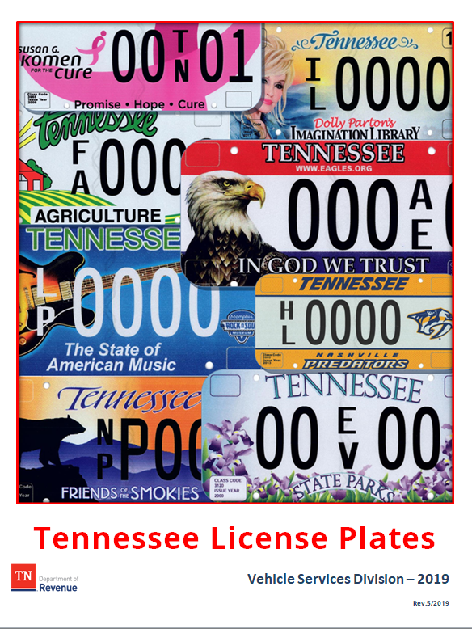
Vehicle Services – License Plate Book
A digital version will be updated regularly and is available in the County Clerk Guide → License Plates → Tennessee License Plates Book
(new plates/designs=frequent updates!)
Please contact CountyClerk.Help@tn.gov when necessary edits are discovered or for suggestions

Slide 4
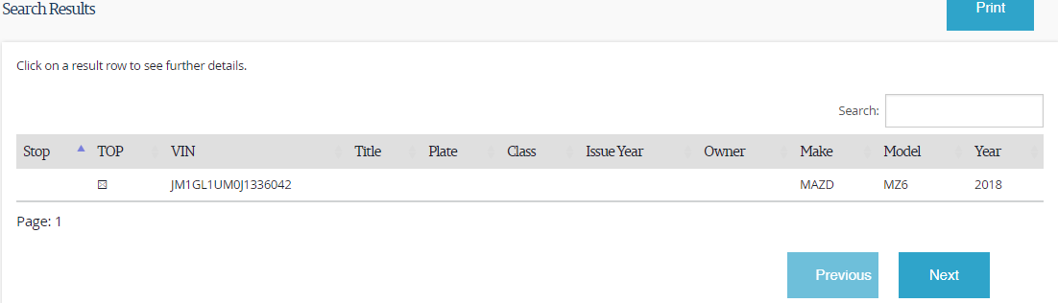
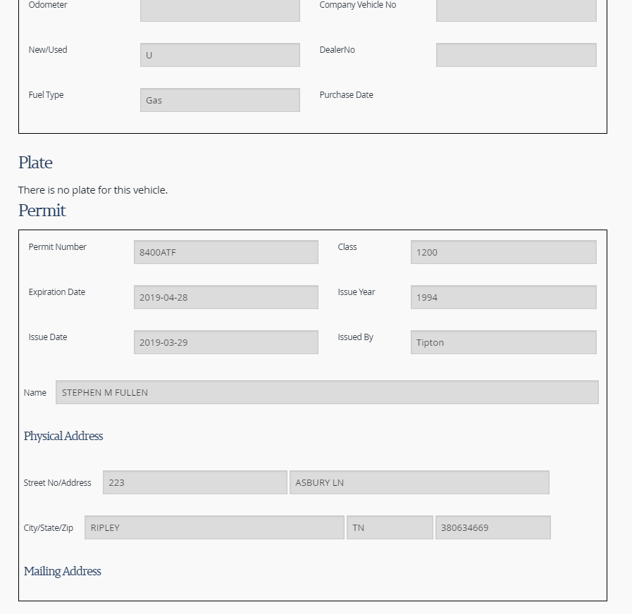
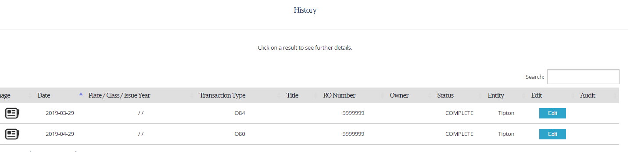
Vehicle Services – New Web Inquiry Features
VTRS search results will indicate if there is a TOP issued for a VIN
Permit and applicant information will appear on the “Vehicle” screen
Transaction history provides more details and images

Slide 5
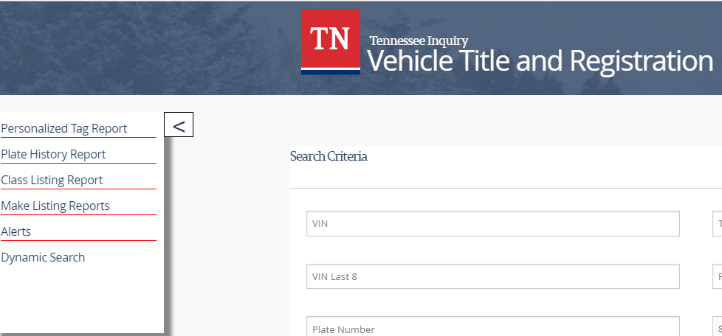
Vehicle Services – New Web Inquiry Features

Slide 6
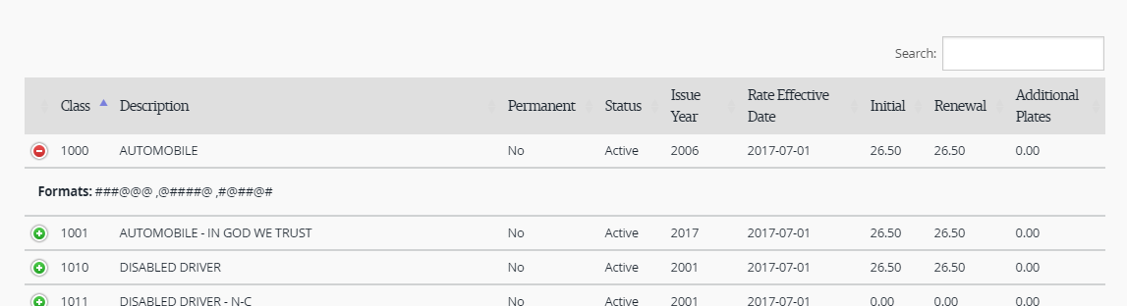
Vehicle Services – New Web Inquiry Features
On the Class Listing Report, click the green + to expand and view available Plate formats
Search by keyword, class code, etc.

Slide 7
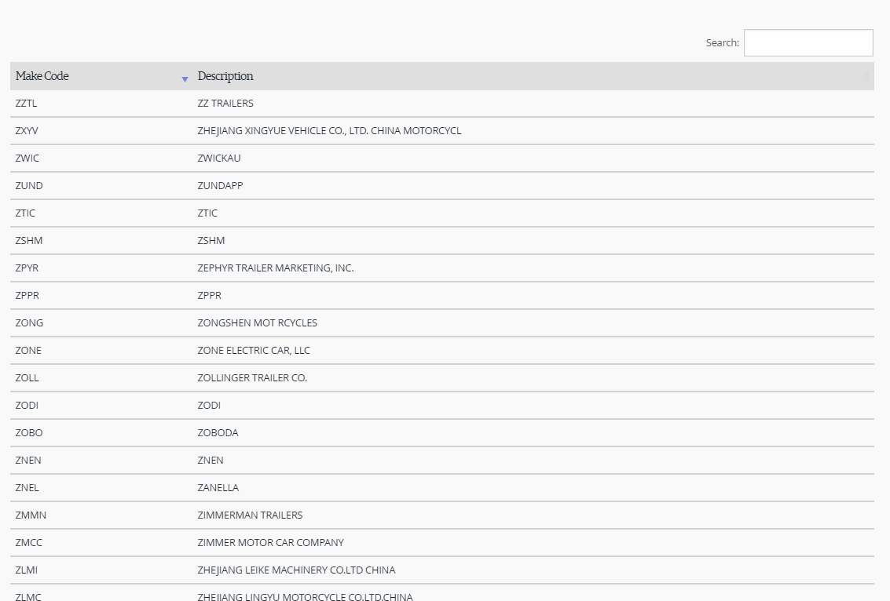
Vehicle Services – New Web Inquiry Features
For makes, search by keyword, code, etc.

Slide 8
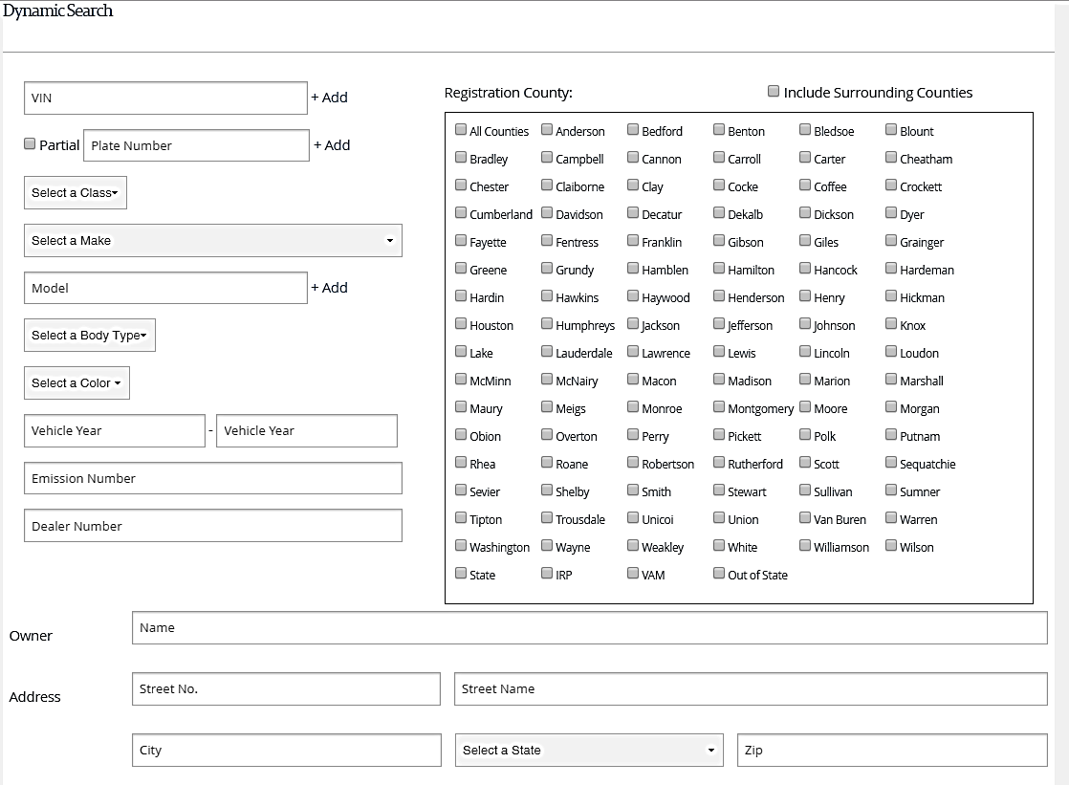
Vehicle Services – New Web Inquiry Features

Slide 9
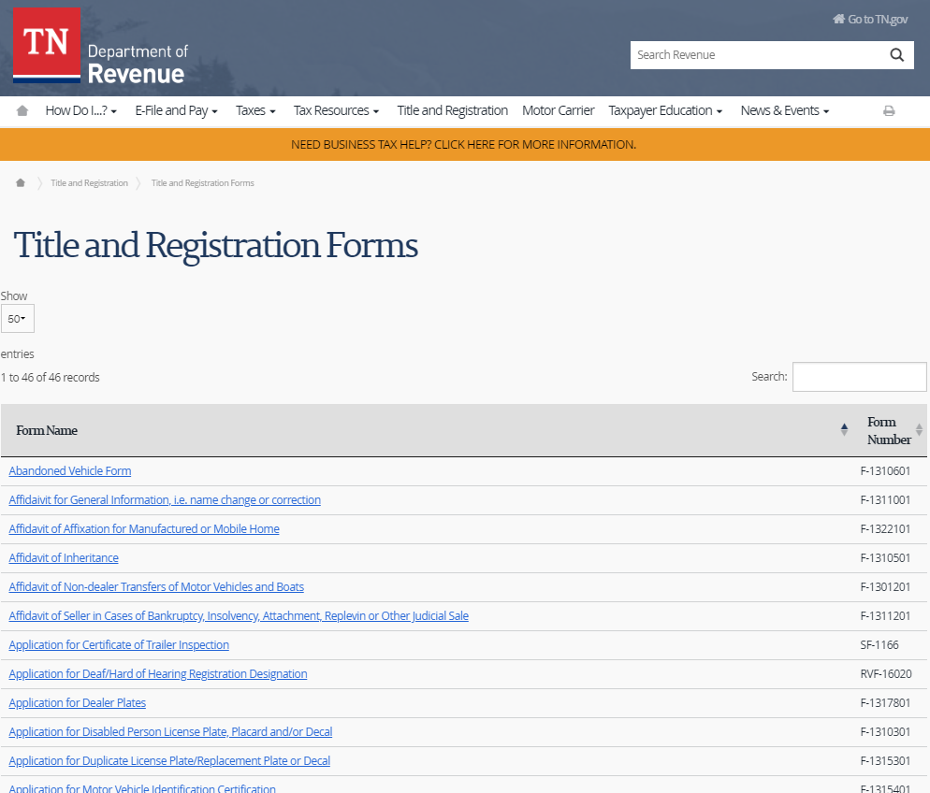
Vehicle Services – NEW FORMS
Many forms are being revised to include:
  overview of the purpose of the form
  clear, concise instructions including next steps
  Organized sections with necessary fields only
IMPORTANT: Please ensure that county websites link directly to Vehicle Services forms at
https://www.tn.gov/revenue/title-and-registration/forms.html
Each individual PDF form can be linked to directly.

Slide 10
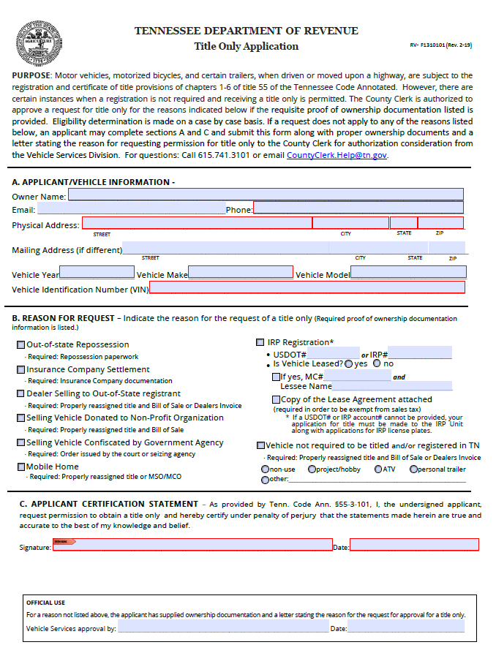
Vehicle Services – NEW FORMS - Title-Only
County clerks may issue title-only for trailers that are not required to be registered and other types of vehicles that are not required to be registered, such as all-terrain vehicles, snowmobiles, or hobby/project vehicles that are not driven on the roads, provided the applicant can supply the requisite proof of ownership of the vehicle.

Slide 11
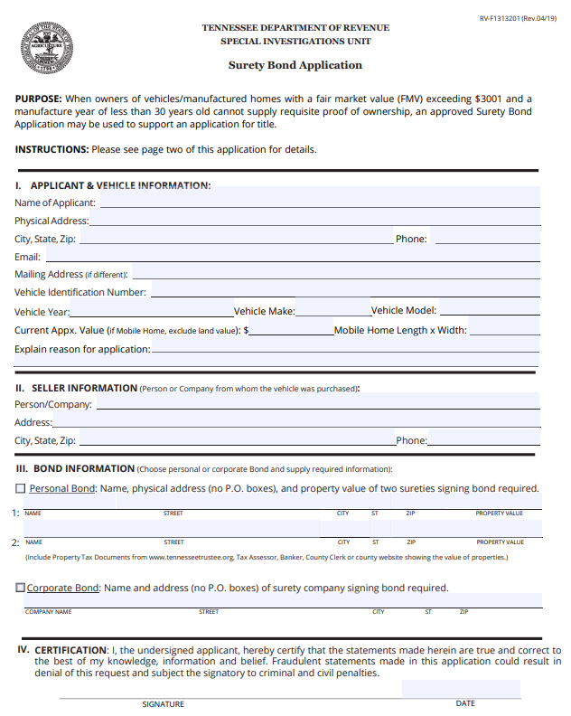
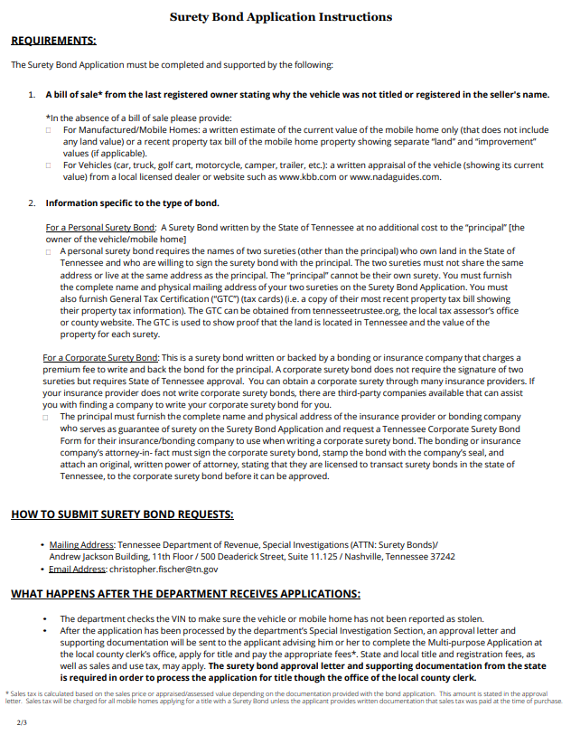
Vehicle Services – NEW FORMS – Surety Bond

Slide 12
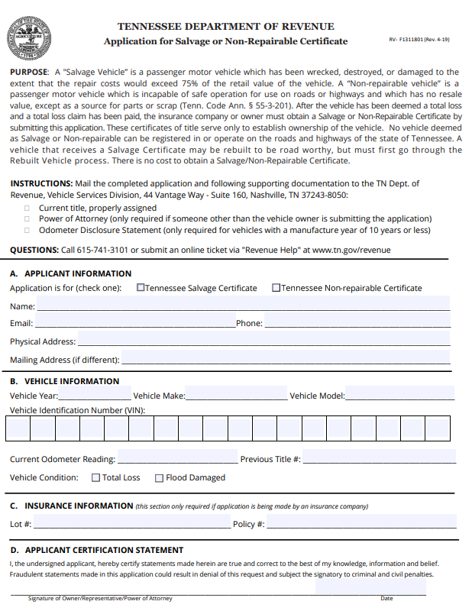
Vehicle Services – NEW FORMS – Salvage

Slide 13
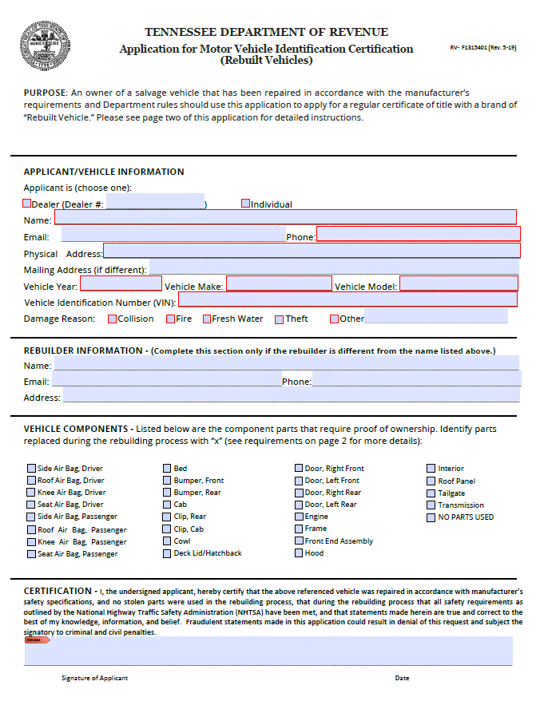
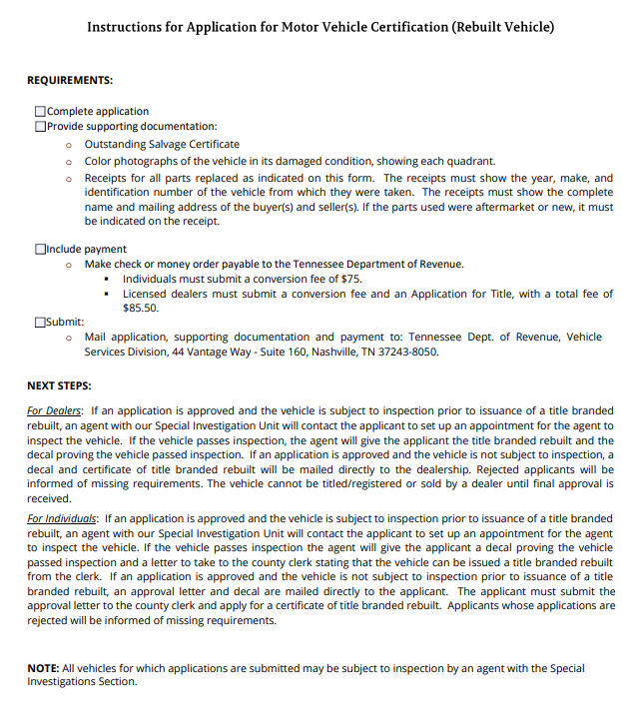
Vehicle Services – NEW FORMS – Rebuilt

Slide 14
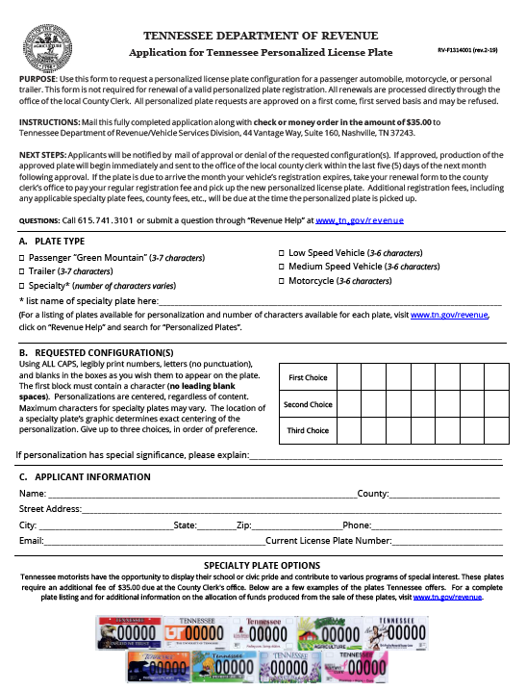
Vehicle Services – NEW FORMS – Coming Soon!
Application for Personalized Plate
Application for Disabled Person License Plate, Placard and/or Decal
Email us at CountyClerk.Help@tn.gov if you have feedback about forms, letters, website, etc.!
DRAFT

Slide 15
Vehicle Services – Recent Guide Updates
Disabled Veteran Plate – Edits regarding new metal
Acceptable Proofs of ID and Residency – New page
Business – Name Change vs. Transfer of Ownership – New page
Transfer of Ownership – Clarified information that a title must be signed by all buyers
Surety Bonds – Multiple edits for clarification
POA Secure – edit: Part C must be completed only if Part A and Part B are completed.
Volunteer Firefighter/Rescue Exemption - Clarified that the exemption applies to any plate, including specialty plates.

Slide 16
Vehicle Services – Recent Guide Updates
Refunds – Added DOR Refund Division contacts + form links
Title Only - New information and updated form
Password & Log In Assistance – new page
Disabled Driver Decal - added specific eligible plate categories
Emergency (E-Plate) – Added that Sheriff’s Deputies do qualify for the plate
Vietnam Veteran Plate – Edit – “Southwest Asia Campaign Medal” required
SOS Safe at Home Requirements – new page
Government Vehicle Overview - Added information about the LESO program
How to Introduce a New Plate – edit: added info about introducing a collegiate plate
Rebuilt – clarified information

Slide 17
Vehicle Services – Recent Guide Updates
Adding/Deleting Employees - Attached updated form.
Legislative Senate & Legislative House - Added Info: All inquires by legislative members about obtaining these plates should be directed to their legislative liaison.
VTRS Edits - Created page detailing when to contact Vehicle Services for certain VTRS edits.
SmartPass - Created page.
5th Special Forces Group License Plate - Clarified verbiage regarding qualification for issuance of plate.
Fees - How to Calculate Credit for Re-registration - Added info about electric fee and specialty/personalized credit
Electric Vehicle Registration Fee - Added info about fee credit calculation
Certification of Ownership – Clarified that the county may issue the title if requirements are met.

Slide 18
Vehicle Services –New, Re-Designed & Upcoming Plates
New License Plates
  Paratroopers –
    3988/2019
  Legislator Emeritus–
    3211/2019
Redesigned License Plates –
  King University –
    3691/2019 – regular
    2251/2019 – personalized
Upcoming License Plates –
  Methodist LeBonheur Healthcare
  Rakkasans

Slide 19
Vehicle Services – LEGISLATION (Plates)
Plates introduced (minimum order required before production):
  Friends of Shelby Bottoms
  Greene County School System
  Knights of Columbus
  Jackson State Univ.
  Tennessee Voices for Victims
  Germantown Charity Horse Show
  Whitehaven High School
  Tennis Memphis
  Service Dogs
  UT Health Science Center
  Juvenile Diabetes Research Foundation
  Linemen Power Tennessee
  Order of the Eastern Star
  Fighting for At Risk Youth
  Blood Donor
  The Center for Living and Learning, Inc
  AMVETS (PC 64)
Period extended for Niswonger Children’s Hospital and Martin Luther King, Jr. plates to meet minimum order requirements

Slide 20
Vehicle Services – LEGISLATION (Plates, cont’d)
Plates to Produce:
  Women Veterans of Color
  Antique Auto (unrestricted use, renewable)
  Legion of Merit
  Somalia Era Veteran
  Operation Inherent Resolve Era
  Korean Defense Service Medal
  Add the word “valor” to current Silver Star plate (PC 171)
Mountain Tough Recovery Team (plate previously introduced but has not yet met minimum order requirements) renamed “Sevier County Partners in Progress Education Foundation”
Dynamic Accessibility Act (PC 112) EFFECTIVE DATE 7/1/2020

Slide 21
Vehicle Services – LEGISLATION (Misc.)
Historic military vehicles exempted from displaying plates. (PC 103) EFFECTIVE DATE: 7/1
Off-highway vehicles capable of holding one passenger may register as Class I, previously 2-4 passengers. (PC 155) EFFECTIVE: 4/18
Exempts certain motor vehicle dismantlers and recyclers from the requirement to keep certain records of transactions of buying or selling automobile parts. (PC190) EFFECTIVE DATE: 7/1
Requirement removed for a towing firm wait 30 days to proceed to sell a vehicle taken into custody. (PC 209) EFFECTIVE DATE: 4/25

Slide 22
Vehicle Services – EIVS
Percentage of Registrants with Insurance Confirmed by County
Anderson | 66.13% |  | Dickson | 82.22% |  | Humphreys | 80.21% |  | Moore | 82.98% |  | Trousdale | 79.68%
Bedford | 72.31% |  | Dyer | 77.89% |  | Jackson | 82.53% |  | Morgan | 69.62% |  | Unicoi | 78.27%
Benton | 78.59% |  | Fayette | 82.56% |  | Jefferson | 81.70% |  | Obion | 80.37% |  | Union | 77.91%
Bledsoe | 77.68% |  | Fentress | 79.32% |  | Johnson | 75.62% |  | Overton | 83.60% |  | Van Buren | 80.14%
Blount | 72.98% |  | Franklin | 82.08% |  | Knox | 81.72% |  | Perry | 79.66% |  | Warren | 78.18%
Bradley | 79.88% |  | Gibson | 81.83% |  | Lake | 75.05% |  | Pickett | 77.91% |  | Washington | 81.49%
Campbell | 77.92% |  | Giles | 80.16% |  | Lauderdale | 77.51% |  | Polk | 80.46% |  | Wayne | 80.73%
Cannon | 80.54% |  | Grainger | 77.47% |  | Lawrence | 82.78% |  | Putnam | 81.51% |  | Weakley | 82.93%
Carroll | 82.80% |  | Greene | 80.11% |  | Lewis | 81.77% |  | Rhea | 75.20% |  | White | 80.92%
Carter | 77.62% |  | Grundy | 77.96% |  | Lincoln | 83.90% |  | Roane | 81.62% |  | Williamson | 88.75%
Cheatham | 80.15% |  | Hamblen | 76.24% |  | Loudon | 82.68% |  | Robertson | 79.02% |  | Wilson | 85.85%
Chester | 80.81% |  | Hamilton | 81.33% |  | McMinn | 77.70% |  | Rutherford | 82.77%
Claiborne | 79.98% |  | Hancock | 79.46% |  | McNairy | 79.32% |  | Scott | 79.79%
Clay | 79.99% |  | Hardeman | 77.76% |  | Macon | 79.60% |  | Sequatchie | 69.15%
Cocke | 77.42% |  | Hardin | 79.85% |  | Madison | 77.27% |  | Sevier | 75.46%
Coffee | 78.02% |  | Hawkins | 82.77% |  | Marion | 76.46% |  | Shelby | 71.49%
Crockett | 78.29% |  | Haywood | 80.59% |  | Marshall | 82.45% |  | Smith | 80.12%
Cumberland | 77.99% |  | Henderson | 80.52% |  | Maury | 80.85% |  | Stewart | 81.99%
Davidson | 77.02% |  | Henry | 81.73% |  | Meigs | 77.00% |  | Sullivan | 81.01%
Decatur | 82.42% |  | Hickman | 80.52% |  | Monroe | 77.20% |  | Sumner | 85.80%
DeKalb | 78.04% |  | Houston | 80.51% |  | Montgomery | 75.98% |  | Tipton | 81.51%

Slide 23
Taxpayer Services – Business Tax
Thanks for a great filing season!
Many taxpayers have successfully filed and paid their tax
Few issues with BIS and the business tax portal remain; none affect your receipt of business tax collected
BIS and Revenue continue to work to resolve issues

Slide 24
Business Tax: Special Location Information
Cable providers, persons providing overnight lodging for cabins, etc., and cellular telephone providers require special treatment
One location only per jurisdiction where they receive gross income
Counties and cities get their share of revenues
Please contact Revenue if you run into any issues

Slide 25
Trailers for Farmers, Nurserymen,
& Timber Harvesters
Public Chapter 178 exempts any trailer from sales tax for a person using a valid agricultural tax exemption certificate
Tax-free trailers include those used to transport the goods, supplies, or equipment.
“… or for any other agricultural purpose relating to the operation and maintenance of a farm.”
Clerks are to accept the certificates; farmers are responsible to ensure the qualifying item is exempt
Takes Effect July 1, 2019 – just livestock trailers until then

Slide 26
Other Sales Tax Issues
Vehicles that are titled in the name of an individual and a non-profit organization are not exempt from sales tax
Mobility enhancing equipment on motor vehicles is exempt from sales tax; the vehicle itself is not. (Important Notice 07-22)
Qualifying VA Automobile Grant recipients are exempt from sales tax on qualifying vehicles (Important Notice 18-15)
Class 1 side-by-side vehicles used principally to produce agricultural products are exempt from sales tax when using an agricultural exemption certificate

Slide 27
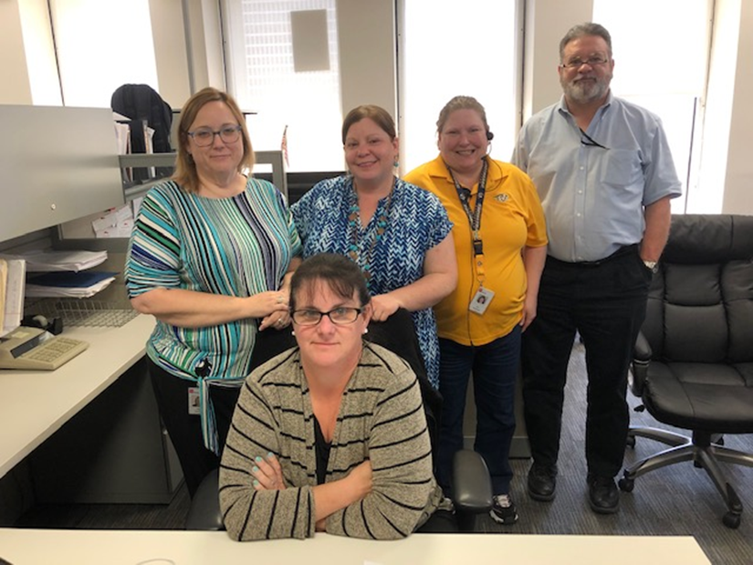
Taxpayer Services: Helpful Telephone Numbers
County Clerk Hotline: 615/532-4096 (clerks and staff only!)
Call Center: 800/342-1003 or 615/253-0600 (business owners)
Penalty Waiver Unit: 615/837-5363
Refund Unit: 615/741-0443
Use Revenue Help! @
www.TN.gov/Revenue

Slide 28
Dept. of Revenue - Important Links
About the Dept. of Revenue (video)
  https://www.youtube.com/watch?v=EqVehaU27QE&feature=youtu.be
Department of Revenue’s website
  https://www.tn.gov/revenue/
Revenue’s Annual Report
  https://www.tn.gov/revenue/news---events/hot-topics/annual-report-now-available.html
Legislative Summaries
  https://www.tn.gov/revenue/tax-resources/legal-resources/legislative-summaries.html
County Clerk Guide (T&R)
  https://tnclerks.zendesk.com
VTRS Web Inquiry
  https://vehiclelookup.revenue.tn.gov/#/login
Online Law Book
  http://www.lexisnexis.com/hottopics/tncode/
Revenue Help (all FAQs)
  https://revenue.support.tn.gov/hc/en-us

Slide 29
Questions?

Slide 30

Thank you!

