Slide 1
County Clerk Spring Regional Meetings
2019

Slide 2
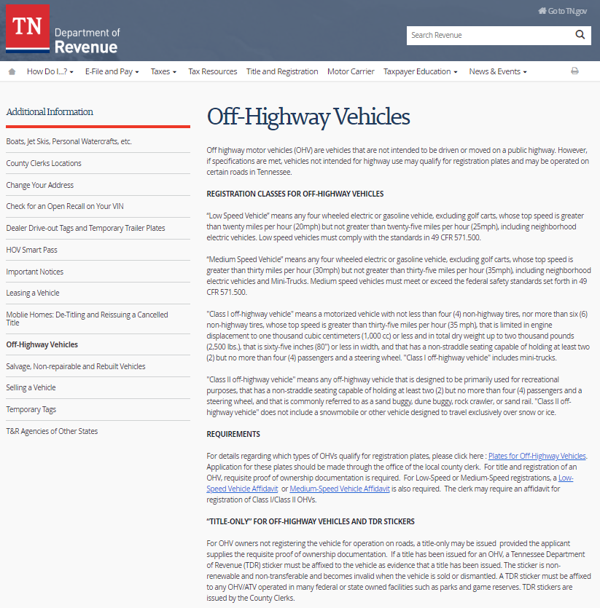
Vehicle Services - Class I/II, Low and Medium Speed
NEW INFORMATIONAL WEBPAGE FOR CUSTOMERS
Navigate to
www.TN/gov/Revenue
Title and Registration
  Additional Information
The new webpage includes:
Listing of classes
Link to Specifications
Requirements
Affidavit Links
Title-Only
TDR

Slide 3
Vehicle Services - Requiring Additional Information
The provisions of Tenn. Code Ann. § 55-2-107 allow clerks to “examine and determine the genuineness, regularity and legality of every application, and may in all cases make investigation as may be necessary or require additional information, and shall reject any application if not satisfied of the genuineness, regularity or legality of the application or the truth of any statement contained in the application.”

Slide 4
Vehicle Services - Surety Bonds: Requirements
The Surety Bond Application must be completed and supported by the following:
1. A bill of sale from the last registered owner stating why the vehicle was not titled or registered in the seller's name.
IF NO BILL OF SALE, THE FOLLOWING IS ACCEPTABLE:
Manufactured/Mobile Homes:
  a written estimate of the current value of the mobile home only (that does not include any land value) or a recent property tax bill of the mobile home property showing separate “land” and “improvement” values (if applicable).
Vehicles (car, truck, golf cart, motorcycle, camper, trailer, etc.):
  a written appraisal of the vehicle (showing its current value) from a local licensed dealer or website such as www.kbb.com or www.nadaguides.com.

Slide 5
Vehicle Services - Surety Bonds: Requirements
The Surety Bond Application must be completed and supported by the following:
1. A bill of sale from the last registered owner stating why the vehicle was not titled or registered in the seller's name.
IF NO BILL OF SALE, THE FOLLOWING IS ACCEPTABLE:
Manufactured/Mobile Homes:
  a written estimate of the current value of the mobile home only (that does not include any land value) or a recent property tax bill of the mobile home property showing separate “land” and “improvement” values (if applicable).
Vehicles (car, truck, golf cart, motorcycle, camper, trailer, etc.):
  a written appraisal of the vehicle (showing its current value) from a local licensed dealer or website such as www.kbb.com or www.nadaguides.com.

Slide 6
Vehicle Services - Surety Bonds: Requirements
2. Information specific to the type of bond.
Personal Surety Bond Requirements:
The name and address of two (2) sureties, who must live at different addresses than each other and cannot live at the same address as the principal, must be provided on the Surety Bond Application.
For both sureties, provide General Tax Certification ("GTC"). The GTC can be obtained from tennesseetrustee.org, the local tax assessor’s office or county website. The GTC is used to show proof that the land is located in Tennessee and the value of the property for each surety.
Corporate Surety Bond Requirements:
The complete name and physical address of the insurance provider or bonding company who serves as guarantee of surety on the Surety Bond Application.
A TN Corporate Surety Bond Form requested from the insurance/bonding company to use when writing a Corporate Surety Bond. The bonding or insurance company’s attorney-in-fact must sign the Corporate Surety Bond, stamp the bond with the company’s seal and attach an original, written power of attorney, stating that they are licensed to transact Surety Bonds in the state of Tennessee, to the Corporate Surety Bond before it can be approved.

Slide 7
Vehicle Services - Surety Bonds: How To Submit
Mailing Address:
  Tennessee Department of Revenue, Special Investigations
  (ATTN: Surety Bonds)
  Andrew Jackson Building, 11th Floor
  500 Deaderick Street, Suite 11.125
  Nashville, Tennessee 37242
Email Address: christopher.fischer@tn.gov
Fax: (615) 532-7835

Slide 8
Vehicle Services - Surety Bonds: How To Submit
Mailing Address:
  Tennessee Department of Revenue, Special Investigations
  (ATTN: Surety Bonds)
  Andrew Jackson Building, 11th Floor
  500 Deaderick Street, Suite 11.125
  Nashville, Tennessee 37242
Email Address: christopher.fischer@tn.gov
Fax: (615) 532-7835

Slide 9
Vehicle Services - Surety Bonds: Next Steps
The department checks the VIN to make sure the vehicle or mobile home has not been reported as stolen.
After the application has been processed by the department’s Special Investigation Section, an approval letter will be sent to the applicant advising them to complete the Multi-purpose Application at the local County Clerk’s office, apply for title and pay the appropriate fees. State and local title and registration fees as well as sales and use tax* may apply. The surety bond approval letter from the state is required in order to process the application for title through the office of the local County Clerk.
* Sales tax will be charged for all mobile homes applying for a title with a Surety Bond unless you can provide written documentation that sales tax was paid at the time of purchase.

Slide 10
Vehicle Services - Surety Bonds: Miscellaneous
Surety Bonds cannot be written for any permanenty affixed mobile home (Affidavit of Affixation on file in the county Register of Deeds’ office)
A physical address of where the manufactured/mobile home is located must be provided on all Surety Bond applications for mobile homes.
The value of the surety bond is calculated at one and one-half (1½) times the fair market value of the vehicle.
The state of Tennessee will only write a Surety Bond for any person or company that is a resident of or have a residence or office address in Tennessee.
The issued bond is maintained in a file for a period of three years. The bond may be returned at the end of the three years or prior if the vehicle is no longer registered in this state and the certificate of title has been surrendered to the department.

Slide 11
Vehicle Services –
Manufacturer/Transporter Plates
"Transporter" means every person engaged in the business of delivering vehicles
  may operate or move any vehicle that may be legally operated under a regular vehicle registration upon any highway within this state solely for the purpose of delivery
  must show proof, such as a business license, that identifies them as a transporter.
"Manufacturer" means every person engaged in the business of constructing or assembling vehicles
  must have valid MVC license identifying them as a manufacturer.

Slide 12
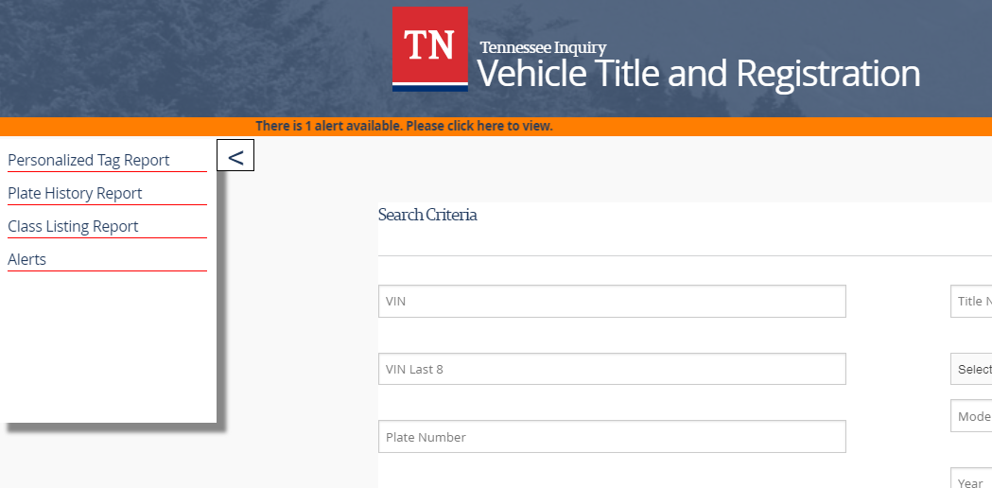
Vehicle Services - VTRS Web Inquiry: New Features

Slide 13
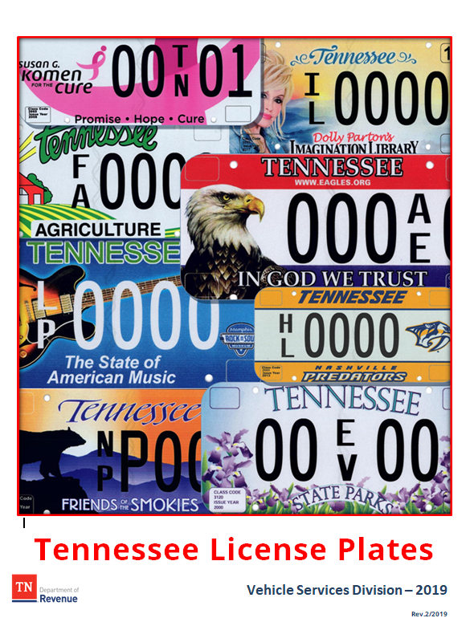
Vehicle Services – Misc.
“Not Available For Update”
  Clerks have reported that Incomplete letters and images are not in VTRS. BIS is aware of the issue.
HVUT – New Information In Guide
Guide Updates
New License Plate Guide - Coming Soon!

Slide 14
Audit Division – Refund Contacts
Manager: Nena Pace (615) 532-6462
Motor Vehicle Registration (Tag) Refunds:
Von Griffin, Auditor (615) 534-6488
Galen Gray, Auditor (615) 770-1952
Ruby Anderson, Supervisor (615) 532-6380
Refunds for Overpaid Sales Tax on Auto/Boat/Other:
Greg Novak, Auditor (615) 532-8248
Evgheni Cuzmin, Auditor (615) 532-6928
Linda Pierce, Supervisor (615) 741-0063
Please contact Auditors and have the VIN and registration information when inquiring about registration refunds.
Reminder – the Department is not authorized to issue refunds for partially used registration renewals. Once a tag has been put in use, it is no longer refundable unless it was originally issued in error.

Slide 15
Taxpayer Services - Gifts
The amount of sales tax on a gift is zero; there is no “consideration” between the two parties
The Affidavit of Non Dealer Transfer of Motor Vehicle or Boat form must be filled out and submitted to Revenue to avoid a sales tax assessment
This information is explained in detail on page 11 of the County Clerk Sales Tax Guide
Businesses cannot gift vehicles to their employees or retirees – their past employment is “consideration”

Slide 16
Taxpayer Services - Transfer of Ownership
Some transfers are taxable; others are not for sales tax
Parent Company LLC with two LLCs under them that are transferring vehicles from one LLC to another are not taxable
Complete listing in county clerk guide on pages 16-18
Helpful chart available in T&R Guide as well

Slide 17
Taxpayer Services - Other Sales Tax Issues
Vehicles that are titled in the name of an individual and a non-profit organization are not exempt from sales tax
Mobility enhancing equipment on motor vehicles is exempt from sales tax; the vehicle itself is not. (Important Notice 07-22)
Qualifying VA Automobile Grant recipients are exempt from sales tax on qualifying vehicles (Important Notice 18-15)
Class 1 side-by-side vehicles used principally to produce agricultural products are exempt from sales tax when using an agricultural exemption certificate

Slide 18
Taxpayer Services - Business Tax
Thanks for your patience!
Taxpayers are successfully filing and paying their tax
Few issues with the business tax portal remain; none affect your receipt of business tax collected
BIS and Revenue continue to work to resolve issues

Slide 19
Taxpayer Services - Helpful Telephone Numbers
County Clerk Hotline: 615/532-4096 (clerks and staff only!)
Call Center: 800/342-1003 or 615/253-0600 (business owners)
Penalty Waiver Unit: 615/837-5363
Refund Unit: 615/741-0443
Use Revenue Help!
www.TN.gov/Revenue

Slide 20
Dept. of Revenue - Important Links
About the Dept. of Revenue (video)
  https://www.youtube.com/watch?v=EqVehaU27QE&feature=youtu.be
Department of Revenue’s website
  https://www.tn.gov/revenue/
Revenue’s Annual Report
  https://www.tn.gov/revenue/news---events/hot-topics/annual-report-now-available.html
Legislative Summaries
  https://www.tn.gov/revenue/tax-resources/legal-resources/legislative-summaries.html
County Clerk Guide (T&R)
  https://tnclerks.zendesk.com
VTRS Web Inquiry
  https://vehiclelookup.revenue.tn.gov/#/login
Online Law Book
  http://www.lexisnexis.com/hottopics/tncode/
Revenue Help (all FAQs)
  https://revenue.support.tn.gov/hc/en-us

Slide 21

Thank you!

