Slide 1
Vehicle Services Division
TN Association of County Clerks – November 6, 2018

Slide 2
Vehicle Services Q&A Topics
Surety Bonds
Class I, Class II, Low and Medium Speed
Relinquishing Rights to Personalized Plates
Non-Repairable (Red KY Title), Salvage Vehicles, Rebuilt Process
Trusts
Business Owned Trucks
Motor Carrier – IRP/Apportioned Registrations
Davidson County Questions
Death, Purchase Date, Odometer and Conjunction “OR”
Important Links

Slide 3
Surety Bond Process
If an applicant is unable to obtain a title to a vehicle through the normal process they can apply to the department if they meet certain criteria for a surety bond. If there are no known security interests and the vehicle has not been reported stolen the department may register the vehicle provided certain criteria are met. The vehicle must be less than 30 years old with a fair market value exceeding three thousand dollars ($3,000.00).The value of the surety bond is calculated at one and one-half (1½) times the fair market value of the vehicle.
Please direct applicants to the surety bond application on our website: https://www.tn.gov/content/dam/tn/revenue/documents/forms/titlereg/f1313201Fill-in.pdf Applications can be emailed to christopher.fischer@tn.gov The following information will also be requested:
Verification of the Vehicle Identification Number (VIN) by a law enforcement officer or licensed dealer, a pencil tracing of an embossed or stamped VIN is acceptable.
A notarized bill of sale from the last registered owner or a notarized statement from the seller stating why the vehicle was not titled or registered in the seller' name.
In the absence of a notarized bill of sale or notarized statement, submit a licensed motor vehicle dealer appraisal of the value of the vehicle.
Photographs of the vehicle in its pre-repaired state. If these are not available, post-repair photographs must be submitted, along with a notarized statement from the applicant stating that the pre-repair photographs are not available, and that the applicant was unaware that such photographs were required prior to the repairs being made. If no repairs were made, that fact should be reflected in the statement.
If the bond has been processed and the applicant is approved a letter of verification is mailed from the Special Investigations Division advising them they can complete the process at their local county clerk’s office.
Contact Information:
Please contact Chris Fischer-Special Investigations / Surety Bonds
Andrew Jackson Building / 11th Floor
Phone: 615-365-6225
christopher.fischer@tn.gov

Slide 4
Class I, Class II, Low and Medium Speed
Off-highway motor vehicles are vehicles that are not driven or moved on a public highway. Some off-highway vehicles are allowed on certain roads depending on the vehicle type and specifications. We have 4 plate classes for these vehicles: Low Speed, Medium Speed, Class I and Class II.
REGISTRATION ELIGIBILITY:
“Class I off-highway vehicle" means a motorized vehicle with not less than four (4) non-highway tires, nor more than six (6) non-highway tires, whose top speed is greater than thirty-five miles per hour (35 mph), that is limited in engine displacement to one thousand cubic centimeters (1,000 cc) or less and in total dry weight up to two thousand five hundred pounds (2,500 lbs.), that is eighty inches (80") or less in width, and that has a non-straddle seating capable of holding at least two (2) but no more than four (4) passengers and a steering wheel. "Class I off-highway vehicle" includes mini-trucks.
"Class II off-highway vehicle" means any off-highway vehicle that is designed to be primarily used for recreational purposes, that has a non-straddle seating capable of holding at least two (2) but no more than four (4) passengers and a steering wheel, and that is commonly referred to as a sand buggy, dune buggy, rock crawler, or sand rail. "Class II off-highway vehicle" does not include a snowmobile or other vehicle designed to travel exclusively over snow or ice.
Class I/Class II NOTES:
No affidavit is required for these classes.
Registrants should understand that vehicles registered with these classes may only operate the vehicle on county roads or in other instances provided for by statute. TCA 55-8-203 & 55-8-185 define where these vehicle are allowed. TCA 55-8-203 also details further requirements that these vehicles must possess before they may be operated on the designated roads.

Slide 5
Class I, Class II, Low and Medium Speed continued:
"Low speed vehicle" means any four-wheeled electric or gasoline vehicle, excluding golf carts, whose top speed is greater than twenty miles per hour (20 mph) but not greater than twenty-five miles per hour (25 mph), including neighborhood electric vehicles. Low speed vehicles must comply with the standards in 49 CFR 571.500.
"Medium speed vehicle" means any four-wheeled electric or gasoline-powered vehicle, excluding golf carts, whose top speed is greater than thirty miles per hour (30 mph), but whose maximum speed allowed is thirty-five miles per hour (35 mph) only on streets with a forty mile per hour (40 mph) or less posted speed limit pursuant to § 55-8-191(b)(1), including neighborhood electric vehicles and mini-trucks. Medium speed vehicles must meet or exceed the federal safety standards set forth in 49 CFR 571.500, except as otherwise provided in § 55-4-136.
Low/Medium NOTES:
An affidavit is required for these classes.
For more information, please visit the County Clerk Guide page:
https://tnclerks.zendesk.com/hc/en-us/articles/360000374303-CLASS-I-CLASS-II-OFF-HIGHWAY-VEHICLE-OHV-PLATES

Slide 6
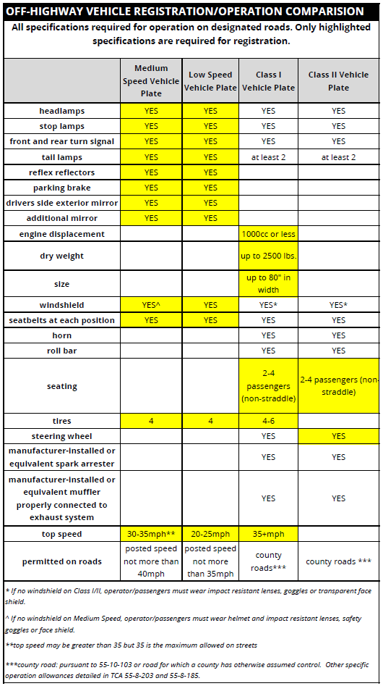
Class I, Class II,
Low and Medium Speed Chart

Slide 7
Relinquishing Rights - Personalized Plates
Relinquishing rights to a plate can only be done on a personalized or specialty personalized plate.
EXCEPTION:
  If a new specialty plate is sent to the county office along with a listing of assigned applicants, these plates can be relinquished only if they have not been picked up from the county.
  The person who the plate is being relinquished to will not have to pay the $35.00 specialty fee that has already been remitted for this plate to be produced.
Required documentation:
  Notarized affidavit from current owner to new owner stating they are relinquishing rights to the customer.
  County must email proof of relinquish of rights to the Plate and Supply Team at dg_plate&supply.team@tn.gov .

Slide 8
Relinquishing Rights Transaction:
There is not an official transaction to relinquish rights. You would simply do the transaction for the type of service the customer is needing.
  Examples:
  If the customer is putting the personalized plate on a vehicle that is already titled in their name but will be receiving credit for the unused portion of the current registration that is on that vehicle, it will be an O03 transaction.
  If the service is being done at the same time as the current registration expires, it will be an O17 transaction.
Steps to relinquish rights to a Personalized plate:
When an individual is relinquishing rights of a personalized plate to another individual, please follow the steps below:
  Notarized affidavit from current owner to new owner they are relinquishing rights to the customer.
  Full fees for plate must be paid by new owner.
  County must email dg_plate&supply.team@tn.gov with proof of relinquished rights and Multi-purpose application so the team can update ownership of the personalized plate.
  Customer may be handed the original plate by former owner. New plate will not be produced unless county specifies that is what the customer wants.

Slide 9
Non-Repairable – Red KY Titles
A Kentucky red title means it’s been heavily damaged and carries a salvage title so it’s not street legal. This is comparable to Tennessee’s Non-Repairable Title; therefore, a regular title cannot be issued. At most we can issue a Tennessee Non-Repairable title. No tags can be issued for a Non-Repairable.
A “Non-repairable vehicle” is a passenger motor vehicle which is incapable of safe operation for use on roads or highways and which has no resale value, except as a
source for parts or scrap.
A “Non-repairable Certificate” also known as a non-repairable title is an ownership document issued by the state to the owner of a non-repairable vehicle.
Note: A passenger motor vehicle for which a Non-Repairable vehicle certificate has been issued can never be titled or registered for use on roads or highways.

Slide 10
Salvage Vehicles
Important Information:
Vehicles that sustain 75% or more damage are deemed a total loss; therefore, a salvage certificate must be issued and the vehicle must be rebuilt prior to putting it back on the road.
If an owner elects to retain the salvage, by law it is the insurance company’s responsibility to notify the owner, to file for a salvage title.
While the vehicle is deemed a total loss or a Salvage vehicle, it cannot be operated on the roads.
Applicant must first obtain a Salvage title and then complete the pre-certification process in order to operate the vehicle on the road.
County Clerk’s may issue a title only to insurance companies for vehicles deemed a total loss.
A Salvage title does show ownership of the vehicle and can be sold to another party if elected to do so.
The Department does not do safety inspections. Our primary focus is to ensure the vehicle meets manufacturer standards and there we no stolen parts used in the pre-certification (rebuilt) process.
Note: County Clerk’s may issue a title only to an Insurance Company on vehicles they have deemed a total loss, provided the Insurance Company submits documentation attesting to the fact the vehicle has indeed been deemed a total loss.

Slide 11
Salvage Vehicles cont.
How to obtain a salvage or non-repairable title:
  Submit current certificate of title along with an application for Salvage/Non-Repairable Certification to:
    TN Dept. of Revenue, 44 Vantage Way, Ste. Nashville, TN 34723
  On the form, please be sure to select TN Salvage Certificate or TN Non-Repairable certificate.
    Salvage certificate will allow the owner to rebuild the vehicle for road use.
    Non-Repairable certificate means the vehicle will be used for parts only and not titled for road use.
There is no cost to obtain a Salvage or Non-Repairable Title.
*Note: The following fields can be left blank on the application: Invoice No., Transaction Type, Certificate Number and Policy Number reason.

Slide 12
Rebuilt Process
Overview:
Any person who has rebuilt a motor vehicle for which the certificate of title or other ownership documents have been surrendered and a salvage title or flood title has been issued shall make an application for a title branded rebuilt prior to selling the vehicle.
The vehicle must go through the rebuilt process prior to being issued a title branded rebuilt.
Laws governing rebuilt and salvage vehicles can be found in the following TCA’s: 55-3-201 through 55-3-210 and 55-17-120(d).

Slide 13
Rebuilt Process cont.
The following must be submitted to Vehicle Services prior to applying for Title and Registration through the County Clerk:
Salvage Title (any State)
Evidence of ownership/Chain of Ownership
Completed application for Motor Vehicle Identification Certification
Receipts for all parts used
  Used parts: receipts must show year, make and VIN from vehicle which parts were taken
  Name and address of seller and buyer must be included on receipts
  New or Aftermarket parts: receipt must indicate parts are new or aftermarket parts
Color photographs showing each quadrant of the vehicle in its damaged state
$75 fee for individual, $85 fee if dealer
Odometer Statement, if applicable
Power of Attorney, if applicable
Upon approval, Revenue will forward the following to the applicant:
Approval letter: This serves as permission to apply for title and registration through the County Clerk’s office.
Copies of documentation submitted during rebuilt process.
Rebuilt Vehicle Anti-Theft Inspection passed decal.
This documentation will be presented at the County Clerk office. The clerk will issue the title in the applicant’s name with the appropriate branding, (ex: Rebuilt, Flood, etc.)

Slide 14
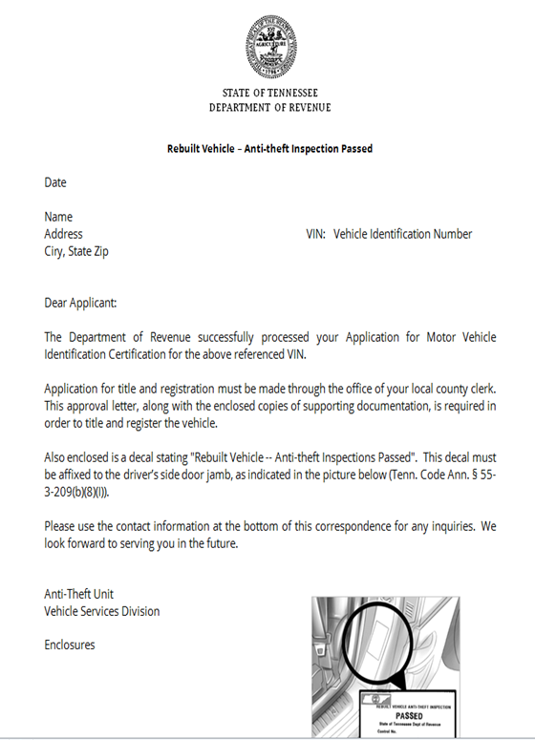
Rebuilt Process cont.
Upcoming Changes and Updates:
In the future, Vehicle Services will no longer mail copies of the documentation submitted with rebuilt transactions with approval letters.
We will continue to send documentation with approval letters until the letter has been revised.
As of October 31, 2018, images are available in Web Inquiry
Sample
Additional Questions? Please contact us!
Vehicle Services Call Center
  615-741-3101 or 888-871-3171
Email: Anti-theft.unit@tn.gov
Anti-Theft Management:
  Jackie Wilson, Vehicle Services Manager, 615-741-6857
  Maria LaBoard, Vehicle Services Manager, 615-253-7255
  Michelle Hudson, Asst. Director, 615-532-1136

Slide 15
TRUSTS – What is a trust?
A trust is a legal agreement generally involving three primary parties:
Trustmaker:
The person who creates the trust agreement, commonly referred to as the Grantor, Trustor or Settlor.
Trustee:
The person or entity responsible for managing the property that the Trustmaker decides to title in the name of the trust.
Beneficiary:
The person or entity that is to receive the benefits of the property that is titled in the name of the trust.
The Trustmaker will transfer ownership of assets to the Trustee who will manage the assets for the benefit of the Beneficiary.

Slide 16
Types of Trusts:
Living Trust
Irrevocable Trust
A Living Trust is an arrangement in which one or more people manage or take care of property for someone else's benefit. A living trust is a trust that is created during your lifetime. In other words, while you are still alive, you transfer title to your property from your name to that of the trustee of the living trust.
Note: Not eligible for tax exempt transfers
An Irrevocable Trust is a legal agreement whose terms cannot be changed by the creator, or grantor, who establishes the trust, chooses a trustee, and names the beneficiary or beneficiaries.
Note: Not eligible for tax exempt transfers

Slide 17
Types of Trusts continued:
Revocable Trust
Perpetual Trust
Revocable Living Trust Law and Legal Definition. A Trust is an entity which owns assets for the benefit of a third person (beneficiary). A Living Trust is an effective way to provide lifetime and after-death property management and estate planning.
Note: Under “Lineal Transfer Provisions” Revocable Trust are tax exempt if transfer is from the creator of the trust into trust ownership.
A Perpetual Trust is a type of Trust that passes from generation to generation so that the children of the original beneficiaries can also benefit from the Trust. A perpetual trust may continue to exist as long as it is needed. For Example: The lifetime of a beneficiary; or the term of a particular charity.

Slide 18
Titling and Registering Vehicles in a Trust
The following documentation is required:
Application for Title and Registration
Certificate of Title
Copy of Trust Agreement, which must include the following:
- The Trust name (example: John Smith Trust or AAA Trust)
- The name of the Trustee (Manager) of the Trust
- The name of the Successor of the Trust (Person who will act as Trustee upon
the death of the Trustee)
- The Trustee’s signature and notarization (In the absence of notarization an
affidavit can be attached to the Trust Document affixed by the Trustee attesting
that it is a “true and accurate copy” of the Trust.
- One of the “Supporting Documents” noted below can be accepted in lieu of the
complete Trust if items listed above are included in the “Supporting Document.”
    Abstract of Trust – Abbreviated synopsis of epitome of facts concentrating on the essential qualities of a larger thing.
    Memorandum of Trust – Implies something less than a complete contract.
    Declaration of Trust – the act by which the person who holds the legal title to the property acknowledges and declares that he holds the same in trust.

Slide 19
Facts to Know About Trusts:
Transfer of ownership from a private individual’s name to Trust’s name is similar to transferring property into a corporation’s name and does constitute a change in ownership.
All transfers of property into or out of the name of any Trust type does constitute a transfer of ownership and is subject to applicable Title and Registration Fees.
Most transfers of ownership to and from Trust ownership are taxable.
Transfers between the “Trustmaker (creator) into a “Revocable Trust,” or those from the Revocable Trust back to the Trustmaker are exempt from tax.
The Trustmaker and the Revocable Trust are “legally undistinguishable” from one another.

Slide 20
Commercial Vehicles
Are business owned pickup trucks required to be registered as commercial vehicles?
Tenn. Code Ann. § 55-4-113(a)(2) requires commercial plates for motor vehicles that are operated “for commercial purposes.” However, the section fails to specify the extent of commercial activity required for a vehicle to be considered to be “operating, for commercial purposes.”
For purposes of Title 55, a “truck” is “every motor vehicle designed, used, or maintained primarily for the transportation of property.” Tenn. Code Ann. § 55-1-104 (emphasis added). Black’s Law Dictionary defines “primary” as “first; principal; chief; leading.” Black’s Law Dictionary (9th ed. 2009).
Current process- Vehicle Services and County Clerks generally require commercial plates for vehicles titled in the name of a business (either as an entity or as a “d/b/a”), regardless of whether the vehicle is an automobile or a truck. If the primary use of the vehicle is for a commercial purpose, then the vehicle should have commercial plates.

Slide 21
Motor Carrier – IRP/Apportioned Registration
Any carrier registering an International Registration Plan(IRP)account is considered apportioned registration.
An apportioned vehicle is any power unit that is used or intended for use in two or more Member Jurisdictions and that is used for the transportation of persons for hire or designed, used or maintained primarily for the transportation of property and;
has two axles and a gross vehicle weight or registered gross vehicle weight in excess of 26,000 pounds, or
has three or more axles, regardless of weight, or
is used in combination, when the gross vehicle weight of such combination exceeds 26,000 pounds.

Slide 22
Motor Carrier - IRP/Apportioned Registrations cont.
When do we need a 2290?
Customer presents a vehicle that is over 60 days from the date of purchase and the vehicle is over 55,000 lbs. gross combined weight.
See DMV Guidance for more information on acceptable proofs of payment.
Title Only Information:
Motor Carrier cannot currently complete title only transactions.
County Clerks can only issue title only if the registrant presents the Title Only – IRP Registration Form.
Customer can also present perjury statement, if they are in-state registrants.
Additional Questions? Please contact us!
Motor Carrier Call Center - 615-399-4265
Robyn Meeks, Vehicle Services Manager
615-532-1265
Robyn.Meeks@tn.gov

Slide 23
Davidson County Questions
Fraudulent Discharge of Liens - we have had a number of fraudulent discharge of liens come through our office recently.
  55-2-107. The department shall examine and determine the genuineness, regularity, and legality of every application for a certificate of registration or title for a vehicle and of any other application lawfully made to the department, and may in all cases make investigation as may be necessary or require additional information, and shall reject any application if not satisfied of the genuineness, regularity, or legality of the application or the truth of any statement contained in the application, or for any other reason, when authorized by law. Please contact our division and we will be more than happy to review an application.
Proof Of Residency - Vehicle titled to parent(s) out of state with a lien. Child is a resident of TN. There has to be a way of registering this vehicle in the state of TN when the title ownership cannot be changed to the child.
  Our statute provides for the registration of vehicles either owned or leased by the applicant. There is no statute that addresses the registration of a vehicle operated by a Tennessee resident, but owned by out-of-state relatives. As the child is neither an owner or a lessee of this vehicle. We do have a Revenue Rule that makes an exception from the registration requirements for students.
  As a possible solution, the child could enter into a lease agreement with their parents and they could bring with them the lease agreement.
Duplicate titles processed 10 or 15 working days from the original issue date?
  Vehicle Services recommends a duplicate certificate of title should not be issued less than fifteen (15) mailing days from the date of issuance of the original title when the owner indicates the title was not received. However, we understand certain situations may require a shorter timeframe. Please check VTRS for the date of the last title issuance.

Slide 24
Death, Purchase Date, Odometer and Conjunction “OR”
When adding an individual to a title that is NOT a spouse - Does the purchase date and odometer change? (We know new title/registration is required - No Sales Tax) – The purchase date remains the same, but the odometer changes.
Vehicle titled to two individuals (NOT spouses) - One of the owners dies. When the surviving owner applies for new title/registration - does the purchase date and odometer change? The purchase date remains the same, but the odometer changes.
If a title is in a joint owner joined by the conjunction “or” the survivor can assign the title over to themselves without evidence of death, whether they are surviving spouse or not. The conjunction “or” requires only one signature at transfer of ownership.

Slide 25
Important Links
About the Dept. of Revenue (video)
  https://www.youtube.com/watch?v=EqVehaU27QE&feature=youtu.be
Department of Revenue’s website
  https://www.tn.gov/revenue/
Revenue’s Annual Report
  https://www.tn.gov/revenue/news---events/hot-topics/annual-report-now-available.html
Legislative Summaries
  https://www.tn.gov/revenue/tax-resources/legal-resources/legislative-summaries.html
County Clerk Guide
  https://tnclerks.zendesk.com
VTRS Web Inquiry
  https://vehiclelookup.revenue.tn.gov/#/login
Online Law Book
  http://www.lexisnexis.com/hottopics/tncode/

