Slide 1
Vehicle Services Division
County Officials Orientation Program 2018

Slide 2
Welcome!
  OVERVIEW OF the TN Dept. of Revenue
  About Vehicle Services
  How each VS work unit works with the counties
  What’s coming up!

Slide 3
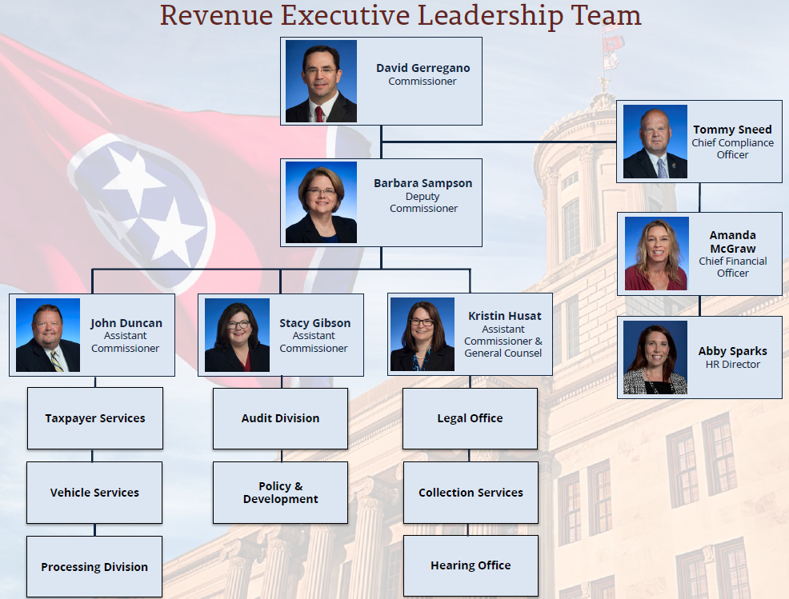
About TN Dept. of Revenue
As Tennessee’s chief tax collector, Revenue (DOR) is responsible for the administration of state tax laws and motor vehicle title and registration laws established by the legislature and the collection of taxes and fees associated with those laws.

Slide 4
LINKS
About the Dept. of Revenue (video)
  https://www.youtube.com/watch?v=EqVehaU27QE&feature=youtu.be
Department of Revenue’s website
  https://www.tn.gov/revenue/
Revenue’s Annual Report
  https://www.tn.gov/revenue/news---events/hot-topics/annual-report-now-available.html
Legislative Summaries
  https://www.tn.gov/revenue/tax-resources/legal-resources/legislative-summaries.html
County Clerk Guide
  https://tnclerks.zendesk.com
VTRS Web Inquiry
  https://vehiclelookup.revenue.tn.gov/#/login
Online Law Book
  http://www.lexisnexis.com/hottopics/tncode/

Slide 5
About Vehicle Services
Vehicle Title & Registration is administered by the Tennessee Department of Revenue through its Vehicle Services Division. Working in concert with the Department of Revenue's Vehicle Services Division, County Clerks in each of Tennessee's 95 counties across the state register vehicles and assist with title transactions. Serving as deputy registrars and agents of the State, County Clerks share responsibility for administering Tennessee's motor vehicle title and registration laws.
County Clerks ensure all vehicles operating on the road are properly titled and registered and also hold the important responsibility of collecting appropriate sales tax and other fees and taxes related to motor vehicles.

Slide 6
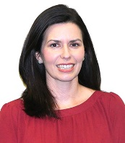

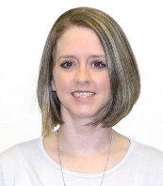
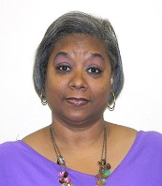
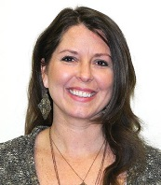


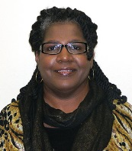
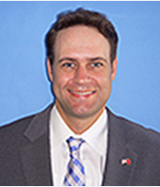



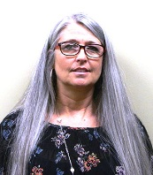
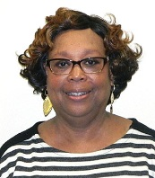

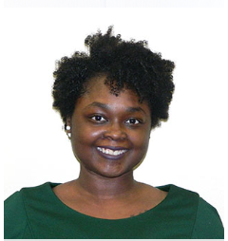

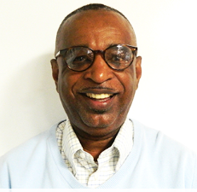
Vehicle Services Division - Administration
Allison Raymer
Vehicle Services Director
Diane Miller
VS Manager
Training and Front Office
Jennifer
Lanfair
Assistant
Director
Michelle
Hudson
Assistant
Director
Katie Bryan
Communications
Manager
Elizabeth Sibal
Manager - Call Center/Research
Maria LaBoard
Manager –
Exceptions/
Operations
Brandon McArthur
County Clerk Liaison
Keri Miano
ASA/Front Office
Amanda Waggoner
ASA/Front Office
Sean Lane
EIVS Manager
Tammie Moyers
Manager –
Exceptions/
Operations
Belinda
Boddie
County Clerk Liaison
Robyn Meeks
Motor Carrier
Manager
Jackie Wilson
Anti-Theft
Manager

Slide 7

About Vehicle Services – Operations Unit
Maria LaBoard, Manager
Maria.LaBoard@tn.gov
615-253-7255
CDPU (County Daily Processing Unit)
Deonna Louallen, Supervisor
Deonna.Louallen@tn.gov, 615-253-5160
Although the majority of titles are issued at local county clerk offices, there are times when the county is not able to issue a title due to a variety of reasons. This work is put into a work grid where the CDPU unit examines applications and then either issues the titles or rejects the application sending a rejection letter to the applicant/lien holder.

Slide 8
About Vehicle Services – Operations Unit
Maria LaBoard, Manager
About Incomplete Applications
WHEN TO SEND A TITLE APPLICATION TO VS
  When the system prohibits due to a fatal stop or system error.
  When an application is supported with an out-of-state registration, with or without a lien.
  When an application is supported with a Salvage or Non-repairable title and the vehicle has not been through the rebuilt process.
  When there is an odometer discrepancy.
  Missing documentation (odometer, signatures, title…)

Slide 9
About Vehicle Services – Operations Unit
Maria LaBoard, Manager
About Incomplete Applications, cont’d
Common reasons counties send incompletes when they can complete it:
  Vehicle was repossessed
  Application is supported with a Divorce Decree
  Application is supported with an Affidavit of Inheritance
  Vehicle is leased
  Confiscated Vehicle Sale
  Sheriff Sale
  Undercover Sale

Slide 10
About Vehicle Services – Operations Unit
Maria LaBoard, Manager
About Incomplete Applications, cont’d
Most common examining issues
  Issuing duplicate prior to 15 days after the initial title issuance
  VIN’s not entered correctly
  Write the word “COPY” on Xerox/scanned copies of titles
  Attaching the out-of-state title to a Registration Transaction
  Failure to bring brands forward from out-of-state titles to Tennessee Titles

Slide 11
About Vehicle Services – Operations Unit
Maria LaBoard, Manager
About Incomplete Applications, cont’d
Tips
  Always check VTRS prior to issuing a duplicate title
  Check VTRS to make sure there are no stops on the record and that the supporting Tennessee title is the most current title
  Check out-of-state titles thoroughly for title brands

Slide 12
About Vehicle Services – Operations Unit
Maria LaBoard, Manager
NOL (Noting of Liens)
Rita Sanford, Supervisor
Rita.sanford@tn.gov, 615-253-7332
This work group examines/keys lien applications and issues titles for Noting of Liens. They also reject applications if documentation is insufficient.

Slide 13
About Vehicle Services – Operations Unit
Maria LaBoard, Manager
NOL (Noting of Liens)
What do clerks need to understand about noting of liens:
  Counties are not to issue noting of liens when an additional lien is being noted. Mark these as incompletes and send to the State. By law we have to notify the 2nd lienholder of their lien notation.
  Noting of Lien Applications must be supported with the Tennessee Title and Security agreement.
  Existing liens must be discharged unless noting an additional lien.

Slide 14
About Vehicle Services – Operations Unit
Maria LaBoard, Manager
NOL (Noting of Liens)
Tips/advice
  Always check VTRS prior to issuing a noting of lien for stops and to make sure the title supporting the noting of lien application is the current title.

Slide 15
About Vehicle Services – Operations Unit
Maria LaBoard, Manager
CERT (Correspondence Error Review Team)
Deonna Louallen, Supervisor
The CERT team examines all returned reject letters and their supporting documents determining if applicants have complied with our request. This team issues the title or re-rejects the documentation for additional information. This team also corrects all title errors.

Slide 16
About Vehicle Services – Operations Unit
CERT (Correspondence Error
Review Team)
Deonna Louallen, Supervisor
Tips/advice
  When documents to clear a rejection are brought into your office, attach a copy of the rejection letter and send to the State.
  Reject letters can usually be found in FileNet.
  If the letter is not available, attach the Batch Category Form.
Maria LaBoard, Manager

Slide 17
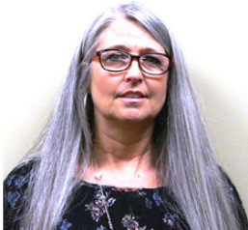
About Vehicle Services – Exceptions & Operations Unit
Tammie Moyers, Manager
Tammie.moyers@tn.gov
615-532-1263
Plate & Supply
Jarvus Jones, Supervisor
Jarvus.jones@tn.gov 615-532-1264
This unit is responsible for handling all plate requests, decal requests (Hearing Impaired, HOV, County Names, Months, Perm Fleet, Disabled, Military, and Surviving Spouse), Dealer Drive Out Tags, Controlled Title Stock, Title Extension Forms, Disabled Placards, Certificates of Destruction, Plate Production/Manufacturing, Reconciling TRICOR Invoices, and keying/destroying returned titles.

Slide 18
About Vehicle Services – Exceptions & Operations Unit
Plate & Supply
What do clerks need to know
  All questions for this group as well as orders for forms/decals/plates should be emailed to dg_plate&supply.team@tn.gov
  Understanding “New Metal” vs. “Redesigned Plates”
  New Metal – All currently registered, under the class type receiving new metal, must receive new metal upon expiration of their current registration. No new metal will be produced and no one can renew on old metal.
  Redesigned – The re-designed plate will receive a new class code and issue year. Customers may choose to keep the old design or change to the new design for an additional $2.00 fee. No further old design will be produced and only the new design will be produced. Counties may choose to destroy the old design or sale it to customers who wish to have the old design.
Important dates
Ordering process
Inventory tips
Tammie Moyers, Manager

Slide 19
About Vehicle Services – Exceptions & Operations Unit
Plate & Supply
Important dates
  TRICOR and Central Stores close for inventory each year the last couple of weeks in June and the first week of July. Please make sure you have reviewed your inventory for needed items and if possible email dg_plate&supply.team@tn.gov the last week of May no later than the first week of June.
  Here is a timeline of license plates that receive new metal every year or every other year.
    Dealer - yearly
    Rescue Squad -yearly
    National Guard Officers - yearly
    Tennessee State Guard Officers - yearly
    Supreme Court Judiciary- every odd year
Tammie Moyers, Manager

Slide 20
About Vehicle Services – Exceptions & Operations Unit
Plate & Supply
Ordering Process
  Complete the “Order request for Forms” or an “Order Request for License Plates”, found in the Guide and on the revenue website forms page.
  Email the form to dg_plate&supply.team@tn.gov (faxing not recommended)
Inventory tips
  Review inventory on a regular basis to ensure that you have a three month supply according to your monthly sales.
  Any obsolete stock should be destroyed in your county
    Complete Certificate of Destruction (in Guide and on forms page) along with an itemized listing of stock (in Guide and on forms page)
    Email completed forms to Vehicle Services Division at dg_plate&supply.team@tn.gov (faxing not recommended)
Tammie Moyers, Manager

Slide 21
About Vehicle Services – Exceptions & Operations Unit
Tammie Moyers, Manager
Renewal/RO (Registration Only)
Betty Sue Wright, Supervisor
Betty.sue.wright@tn.gov 615-253-7276
This unit is responsible for handling Renewal and Registration Only errors. When counties key customer renewals and RO’s, all errors are reported on a daily report. The errors are corrected for the transaction to be completed. This team also works the State Issue RO queue, where scanned RO images are verified for accuracy and the customer’s record is updated in the system

Slide 22
About Vehicle Services – Exceptions & Operations Unit
Tammie Moyers, Manager
What is RO?
Registration Only is simply renewing, transferring, or purchasing a registration for a vehicle that has already been titled and registered in the applicant’s name.

Slide 23
About Vehicle Services – Exceptions & Operations Unit
Tammie Moyers, Manager
Renewal/RO (Registration Only)
Common Errors:
  Renewing a personalized plate that has been expired over 365 days without verifying with Vehicle Services that the applicant is still the owner and there has not been a new owner of the configuration.
Tips/Advice
  License plates that an applicant had to be qualified to receive the license plate can be transferred from two names to one name as long as the one name is the qualifying applicant. Example: Disabled Persons license plate.
  Do not attach the out-of-state title to the Registration Only Application
  Attach a copy of the rejection letter to the out-of-state title and mail to the state.
  Mark the Registration Only transaction as incomplete and send to the State for processing

Slide 24
About Vehicle Services – Exceptions & Operations Unit
Tammie Moyers, Manager
SAT (Specialized Application Team)
Sheila Crockett, Supervisor
Sheila.crockett@tn.gov 615-532-7408
This unit is responsible for handling plate requests by federal government agencies. They also deal with the Title/Registration requests for all state/local government agencies, Bellsouth/UPS fleets, Nissan/Volkswagen OEM, and dealer plates. De-titles (when mobile homes are permanently affixed to land) are also handled by this team.

Slide 25
About Vehicle Services – Exceptions & Operations Unit
Tammie Moyers, Manager
SAT (Specialized Application Team)
Sheila Crockett, Supervisor
  Government Service – must be titled and registered in the government agencies name or leased in the government agencies name prior to registering a blind or undercover registration
  De-Titles – only mobile homes that are being de-titled are processed directly through the State. If they are just titling a mobile home they go directly through the county clerk’s office.
  Fleets – Nissan, Volkswagen, UPS, and FedEx title and register directly through the State.

Slide 26
About Vehicle Services – Exceptions & Operations Unit
Tammie Moyers, Manager
SAT (Specialized Application Team)
Sheila Crockett, Supervisor
What do counties need to know about government registrations, fleets, de-titling?
  Any county may completely process a local government service agency. Do not send these in as incompletes unless there is an issue that prevents the county from processing the application.
  If a customer is just titling a mobile home they go directly through the county clerk’s office.
  AT&T and UPS vehicles that are a part of the Commercial Fleet Program processed by the State cannot be renewed by the County Clerk’s.
  Nissan and Volkswagen Fleet Vehicles are processed by the state.
  Questions pertaining to these items may be emailed to dg_SAT.team@tn.gov.

Slide 27

About Vehicle Services – Call Center/Research
Call Center (888)871-3171 or (615)741-3101
Supervisors:
Pamela Pennimon, pamela.pennimon@tn.gov, 615-253-5164
Paula Bynum, paula.bynum@tn.gov, 615-532-7407
Lauren Schexnider, lauren.schexnider@tn.gov. 615-253-7260
This unit is responsible for answering calls from taxpayers, lending institutions, law enforcement, attorneys, dealers, tow companies, garage keepers and other states. Call Center representatives remove stops, update or correct a registration records and key title corrections. They examine documentation for the complete chain of ownership and lien information.
Elizabeth Sibal, Manager
Elizabeth.sibal@tn.gov
615-770-6844

Slide 28
About Vehicle Services – Call Center/Research
Elizabeth Sibal, Manager
Call Center - County Clerk Line (press option 6)
(Supervisors: Pamela Pennimon, Paula Bynum, Lauren Schexnider )
This unit is responsible for answering calls from the 95 county clerk offices. Call Center representatives remove stops, update or correct records and key title corrections. They examine documentation for the complete chain of ownership and lien information from documentation.

Slide 29
About Vehicle Services – Call Center/Research
Elizabeth Sibal, Manager
Counties can now call Vehicle Services for many VTRS edits.
  send requests to CountyClerkHelp@tn.gov or call the call center

Slide 30
VEHICLE SERVICES – VTRS Edits
  Examples:
  Title Status Change: County is attempting to do a transaction with the title and receives message that it is not valid and has been surrendered when it has not. VS can change the title status.
  Change Owner Name/Address/Name Code: The owner’s information is incorrect, possibly due to conversion and the title was already printed with the correct information, VS can make the edit.

Slide 31
VEHICLE SERVICES – VTRS Edits
  Examples, cont’d:
  Change Plate Information (plate number, expiration date, county of registration, class, issue year): County does a renewal then the state does a transaction that sets the expiration date back. VS can update the information.
  Change Former Title/State: County keys the wrong former title number/state. VS can edit the information.

Slide 32
VEHICLE SERVICES – VTRS Edits
  Examples, cont’d:
  Transaction Status Change: County receives “there is a pending incomplete transaction” – VS can change it from Incomplete to Complete.
  Change Vehicle Information: County keys incorrect make, model, year, color, body, odometer indicator, odometer, new/used, fuel type, vehicle type, vehicle use, gross weight, axles, class/seat, company vehicle #, purchase date.

Slide 33
VEHICLE SERVICES – VTRS Edits
  Examples, cont’d:
  Add Lien Holder: County adds a lien to the vehicle but it does not appear on VTRS. VS can add a lien but CANNOT remove a lien.
  VIN correction when correct VIN not already on VTRS: County keys a titling transaction incorrectly. It’s the only transaction for the incorrect VIN and the correct one is not on VTRS and the title has already been issued. VS can go in and change the VIN (not merge VINs).

Slide 34
VEHICLE SERVICES – VTRS Edits
  Vehicle Services can NOT make
  the following edits:
Merge existing records together (wrong and the right VINs are on VTRS with transactions under both)
Remove lienholder
Change/update title #
Pulling a record through that did not make it to VTRS
Change title brands
Remove plate from history
Call BIS with issues completing 03 transaction

Slide 35
About Vehicle Services – Call Center/Research
Elizabeth Sibal, Manager
Research Group/NCIC (National Crime Information Center)
(Supervisors: Pamela Pennimon, Paula Bynum, Lauren Schexnider )
This unit is responsible for examining and processing (or rejecting) Vehicle Information Requests (VIR’s) and Requests for Verification of Ownership (abandoned) applications. This group also includes a Terminal Agency Coordinator with NCIC (National Crime Information Center) who adds and removes stops on reported stolen vehicles, processes the NCIC Hit report in which some VINs are signified as stolen, and runs stolen VINs for Law Enforcement and Vehicle Services teams.

Slide 36
About Vehicle Services – Call Center/Research
Research Group/NCIC (National
Crime Information Center)
(Supervisors: Pamela Pennimon, Paula Bynum, Lauren Schexnider )
  NCIC-only clerks offices may call to inquire about running a VIN for stolen, the customers cannot call themselves.
  For questions about VIRs or AVs, email Vehicleservices.research@tn.gov
  The County Clerk Guide explains exactly what is needed for the county to process AVs.
Elizabeth Sibal, Manager

Slide 37
About Vehicle Services – Motor Carrier
Robyn Meeks, Manager
Robyn.meeks@tn.gov
615-532-1265
IRP (International Registration Plan)
(Supervisor: Romany Hanna, romany.hanna@tn.gov, 615-770-6842)
IRP is an agreement among states of the US, the District of Columbia and provinces of Canada providing for payment of commercial motor carrier registration fees. To operate in multiple states or provinces, motor carriers must register in their base jurisdiction (state or province). The IRP team handles registrations for TN based carriers via TNTAP, mail, fax, e-mail and walk-in. The IRP unit also issues titles and Tennessee Temporary Authorization Permits. Remittance for credentials is accepted and receipts are issued.

Slide 38
About Vehicle Services – Motor Carrier
HVUT
HVUT: a fee assessed annually on heavy vehicles operating on public highways at registered gross weights equal to or exceeding 55,000 pounds.
TNClerk will flag every transaction for applicable plates to prompt the clerk to ask the registrant to provide proof that HVUT was paid OR proof of HVUT exemption. No proof of HVUT or exemption is required within 60 days of the date of purchase of the vehicle.
The HVUT form expires June 30 of each year. However, it must be filed and paid by August 31 of each year. We can accept current year or expired year during the filing period.
Audits are performed each year to ensure proof of HVUT has been acquired by the county and/or state issuing the registration.
Robyn Meeks, Manager

Slide 39
About Vehicle Services – Motor Carrier
IRP
(Supervisor: Romany Hanna)
IRP Title-Only
IRP Registrants have the option to apply for title-only through the county clerk’s office prior to registering the vehicle with IRP. Requirements include:
Form: title only verification for out of state irp registration
Original Title or MSO
  MSO must accompany a bill of sale ALWAYS. Some original titles may not have the bill of sale, but the purchase price must be shown on the title or shown in the title documents.
Sales Tax Exemption, if applicable.
Owner’s Authorization to Lessee form, if applicable.
Robyn Meeks, Manager

Slide 40
About Vehicle Services – Motor Carrier
IRP
(Supervisor: Romany Hanna)
IRP – Sales Tax Exemption
Qualified Sales Tax Exemptions Include:
Registrants who hold Motor Carrier (MC) Number with Federal Motor Carrier Safety Administration- since clerks does not have access to this portal, this number should be included on the form.
- MC numbers are designed for registrants who are Authorized for Hire (TCA 67- 6-331 - The motor vehicle or trailer will be used to transport passengers or cargo principally (more than 50%) in interstate or foreign commerce. )
Registrants who are exempt for hire, meaning exclusively hauling exempt commodities (not federally regulated), are also sales tax exempt. (See Exempt Commodities) Exempt for hire registrants will not hold a MC number and carriers will follow the third option- The motor vehicle or trailer will be used to transport exempt commodities as defined by federal law.
Robyn Meeks, Manager

Slide 41
About Vehicle Services – Motor Carrier
Robyn Meeks, Manager
IFTA (International Fuel Tax Agreement)
(Supervisor: Romany Hanna)
IFTA is an agreement between the lower 48 states of the United States and the Canadian provinces, to simplify the reporting of fuel use by motor carriers that operate in more than one jurisdiction. Operating carriers with IFTA receive an IFTA license and two decals for each qualifying vehicle. The carrier files a quarterly fuel tax report which is used to determine the net tax or refund due and to redistribute taxes from collecting states to states that it is due. This unit verifies and processes applications, keys IFTA tax returns and verifies e-filed returns, issues temporary permits and receipts for remittances (payments through iNovah).

Slide 42
About Vehicle Services – Motor Carrier
Robyn Meeks, Manager
UCR (Unified Carrier Registration) and
Intrastate Authority (Supervisor: Romany Hanna)
Vehicles engaged in interstate travel must register through UCR, based on the size of their fleet. The UCR unit verifies and processes applications, issues receipts utilizing the national UCR database, and issues credentials from the system.
Intrastate Authority allows for-hire motor carriers and private towing and wrecker services to use any of the public highways of Tennessee for the transportation of persons or property, or both, in intrastate commerce. This unit verifies and processes Intrastate Authority applications, verifies and enters Insurance and Process Agent information, assists customers and issues credentials, accepts remittance for credentials and issues receipts through the system.

Slide 43
About Vehicle Services – Anti-Theft Unit
Jackie Wilson, Manager
Jackie.wilson@tn.gov
615-741-6857
Anti-Theft is a unit within Vehicle Services that process applications for Salvage, Non-Repairable and Rebuilt Titles. By law a motor vehicle less than 10 model years old that has sustained 75% or more damage is subject to Salvage and Rebuilt Laws. The vehicle must be issued a salvage certificate until such time it is rebuilt and made road worthy again. Vehicles issued non-repairable titles cannot be driven upon the highways again and can only be used for parts.

Slide 44
About Vehicle Services – Anti-Theft Unit
Jackie Wilson, Manager
The County Clerk’s role in the rebuilt process is to issue a title with the proper brands (rebuilt, flood, etc.), after the vehicle has gone through the rebuilt process and has been approved and inspected by the state.
The owner will bring an approval letter and copies of the ownership documents to the County Clerk’s office for title issuance.
New functionality is being developed by BIS which will eliminate the need for the owner to bring copies of the ownership in to the County Clerk’s Office. The images of the ownership documents will soon be available on VTRS for the County Clerk to access. This new process will also eliminate the need to for the County Clerk to re-enter information in their system as the owner information will populate when the State’s Database is accessed.

Slide 45

About Vehicle Services – EIVS
Shaun Lane, Manager
Antonio.lane@tn.gov
615-770-6835
EIVS
(Electronic Insurance Verification System)
The Tennessee Department of Revenue is launched a new insurance verification system in January 2017 to encourage compliance with the state’s Financial Responsibility Law. Under the program, all insurance carriers registered to write personal automobile liability policies in Tennessee must register with the Department and provide required policy information. The state’s new insurance verification system will check the policies provided by the insurance companies against all currently registered Vehicle Identification Numbers (VINs) in Tennessee. This will happen on a continual basis. If the system is unable to confirm insurance coverage for a vehicle, a notice will be sent to that owner directing the registrant to www.DriveInsuredTN.com where he or she can provide proof of minimum liability insurance or exemption. If a customer does not respond to the initial notice, subsequent notices will follow. Failure to comply with the notices could result in fines and eventual vehicle registration suspension.

Slide 46
About Vehicle Services – EIVS
Shaun Lane, Manager
Clerks assist in confirming insurance and taking payments for EIVS stops when customer goes to renew their vehicle.
The EIVS call center cannot take over the phone payments. Customers can pay at DriveInsuredTN.com, pay at their local county clerk or send in a money order to Vehicle Services
When EIVS information is being imputed, information needs to be saved at State level as well for the updated information to display at the EIVS call center

Slide 47
About Vehicle Services – EIVS
Shaun Lane, Manager
Customers can use the website (www.driveinsuredtn.com) to make payments and submit insurance information to confirm insurance.
Customers need to have their pin number (which can be found on the notice they received) and the plate number of the vehicle in question to log in.
All affidavits for exemptions can also be submitted through the website.
Reach the EIVS Unit directly at (888)871-3171 or (615)741-3101, OPTION 2

Slide 48
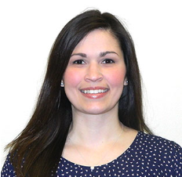
About Vehicle Services – Administration Support and Training
Diane Miller, Manager
Diane.miller@tn.gov
615-253-0093
The Administrative team works to support our internal staff as well as external customers. This unit handles calls, supply requests and orders, onboarding and off boarding, job postings, invoices, RFS requests, general HR inquiries, time entry, data entry, badge access and often times are assigned special projects. This unit is essentially the liaison between Vehicle Services and other divisions in and outside of Revenue. The Training Officer coordinates and tracks training requirements for employees in the Vehicle Services Division and works with the management staff on special projects.

Slide 49

About Vehicle Services – Communications
Communications/County Clerk Support
County Clerk Liaisons:
Belinda Boddie, belinda.boddie@tn.gov, 615-532-1137
Brandon McArthur, brandon.mcarthur@tn.gov, 615-532-1139
This work group assists County Clerks, Department Staff, and the general public with title and registration questions that require additional attention. They work with management staff to ensure answers to questions are consistent with the law and divisional policies and procedures, updating the County Clerk Guide, website, forms and letters as needed.
When hiring a new employee, modifying employee information or system access level or removing system access for an employee, the county submits the add/modify/delete request to this group.
Other responsibilities of this group include creating fiscal impact notes for proposed legislation, handling commissioner/governor/legislator constituent complaints and visiting county offices.
Katie Bryan, Manager
Katie.julian@tn.gov
615-253-7262

Slide 50
About Vehicle Services – Communications
Print-On-Demand paper is automatically
sent to counties on the following dates. Quantity is
based on the prior years usage plus a percentage of overage. Supplemental shipments may be requested.
  December 1
  March 1
  June 1
  September 1
Katie Bryan, Manager
Add/modify/delete employees –
  Fill out the VTRS Access Revision Form/Confidentiality Disclosure of Tennessee
  Send to countyclerk.help@tn.gov

Slide 51
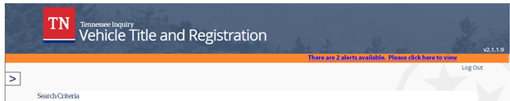
About Vehicle Services – Communications
How Vehicle Services
Communicates with County Clerk Offices
  Newsletter
  Emails
  County visits
  COAT, Summer Clerks Meeting, regional meetings
  County Clerk Guide (always check “Guide Updates”)
  Upcoming VTRS Message Alert System
Katie Bryan, Manager

Slide 52
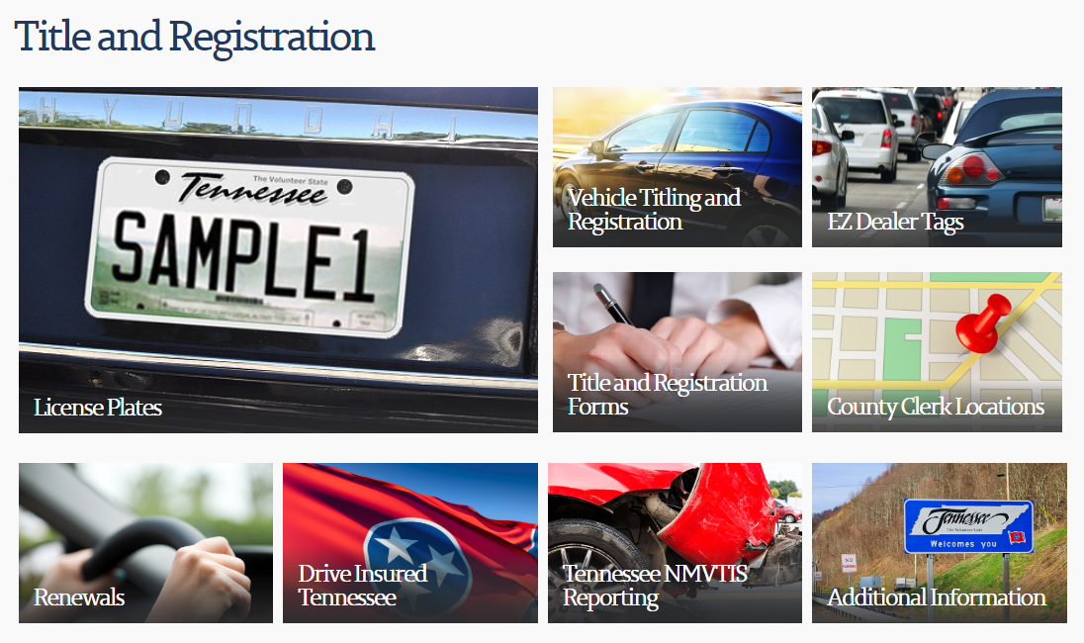
About Vehicle Services – Communications
Title & Registration Website
www.tn.gov/revenue
Katie Bryan, Manager

Slide 53
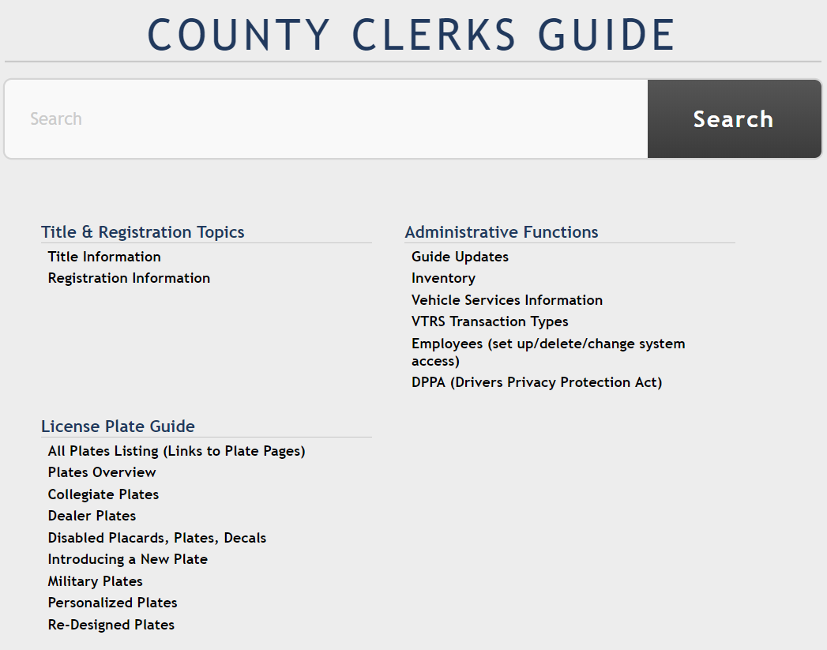
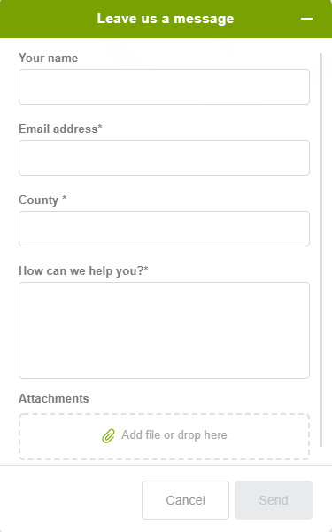

About Vehicle Services – Communications
County Clerk Guide
https://tnclerks.zendesk.com/hc/en-us
Katie Bryan, Manager

Slide 54
Vehicle Services
VTRS AFTER GO-LIVE PRIORITIES
EZ Tag
Electronic lien and title (ELT)
NMVTIS
Online Personalized Plate Ordering
VTRS Fee Report button

Slide 55
QUESTIONS/COMMENTS
Thank you!!!

