Slide 1
Vehicle Services Division
County Clerks Spring Conference 2018

Slide 2
VTRS
Welcome!
  Vehicle Services Updates
  EIVS Updates
  VTRS Updates
  Legislation
  New T&R Guide
  Other Important Information

Slide 3








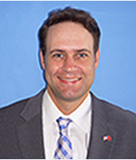



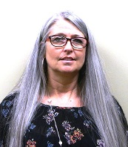
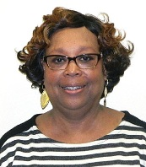


Vehicle Services Division - Administration
Allison Raymer
Vehicle Services Director
Diane Miller
VS Manager
Training and Front Office
Jennifer
Lanfair
Assistant
Director
Michelle
Hudson
Assistant
Director
Katie Bryan
Communications
Manager
Elizabeth Sibal
Manager - Call Center/Research
Maria LaBoard
Manager –
Exceptions/
Operations
Brandon McArthur
County Clerk Liaison
Keri Miano
ASA/Front Office
Amanda Waggoner
ASA/Front Office
Sean Lane
EIVS Manager
Tammie Moyers
Manager –
Exceptions/
Operations
Belinda
Boddie
County Clerk Liaison
Alaina
Burford
Motor Carrier
Manager

Slide 4
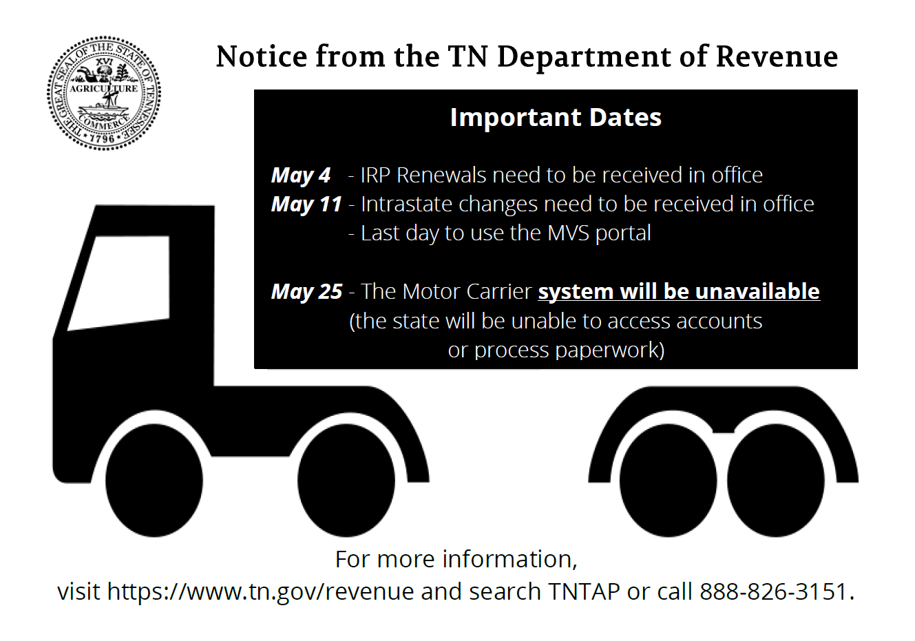
Motor Carrier (IRP/IFTA/Intrastate)

Slide 5
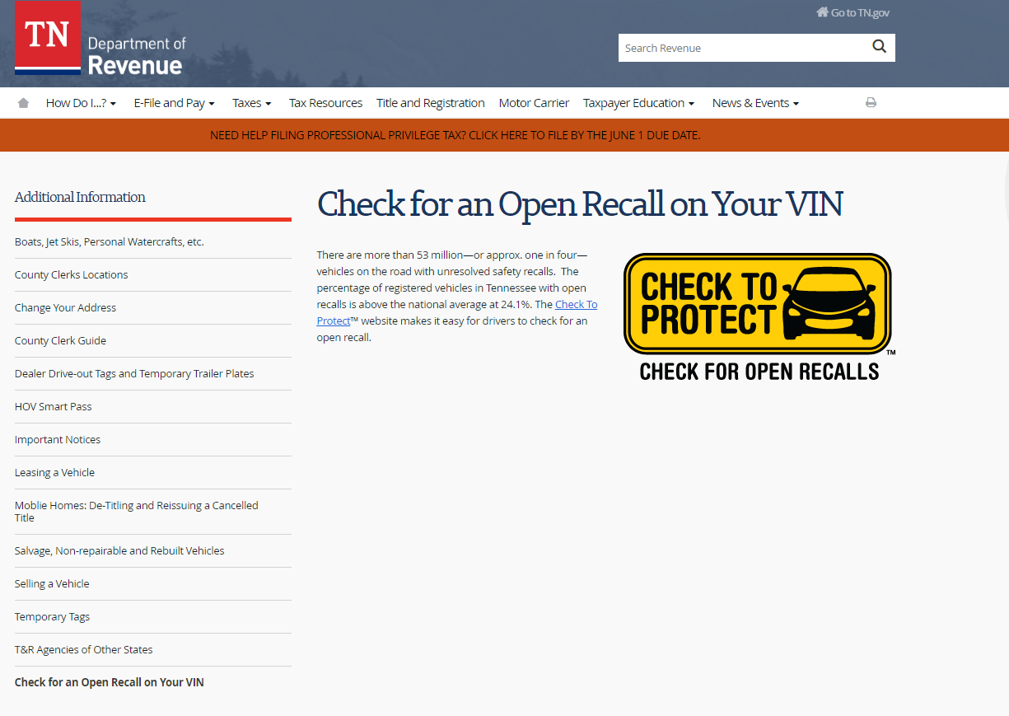
Check to Protect

Slide 6
EZ Tag
Dealer Drive Out By: Katie Bryan
•Number of dealerships signed-up: 1175
•Number of active dealerships: 895
•Number of tags issued from beginning to date: 461,613
•Number of tags issued from July 2017 to date: 312,955
•Number of tags issued from year to date: 154,374
•Number of tags issued in 2016: 36,614
•Number of tags issued in 2017: 270,625
I

Slide 7
Employee Recertification
Each year the Department of Revenue is required to recertify all County Clerk users that have access to departmental systems that contain tax information or vehicle title and registration information.
Per state policy, any time a county has a user that leaves employment the county MUST submit a request to delete the user from state systems on the individual’s final day at work.
This request must be in the form of the “VTRS Access Revision Form” and must have a physical signature for the request to be valid.
Please email this form to Belinda Boddie (Belinda.Boddie@tn.gov) and the Department of Revenue Security Team will promptly begin removing the user.
For employees on extended leave two weeks or longer, or seasonal employees who complete their term of employment, a request to delete must also be submitted on or before the employee’s final working day. When the individual returns to work, a request to add should be submitted to re-enable their account. Your help in following these policies is essential to keeping our systems secure and our fellow citizens’ personal information safe.

Slide 8
EIVS Timeline
May 20, 2015 Electronic Insurance Verification Law passed
June 1, 2016 www.driveinsuredTN.com website launched
December 30, 2016 The Department of Revenue certified EIVS as operational
January 1, 2017 EIVS program goes live with a functional customer interface
January 10, 2017 FBOB Confirmed 73% coverage on active registrations
January 15, 2018 FBOB Confirmed 77.89% coverage on active registrations
Total EIVS letters sent to registrants 114,106 since roll-out.
90,087 letters YTD 2018
10,556 4th notice suspension letters

Slide 9
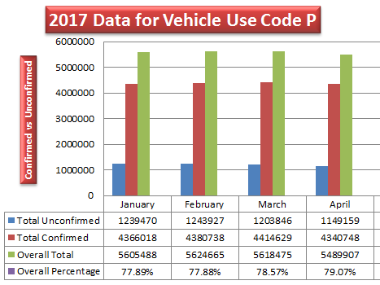
EIVS April Comparison Report

Slide 10
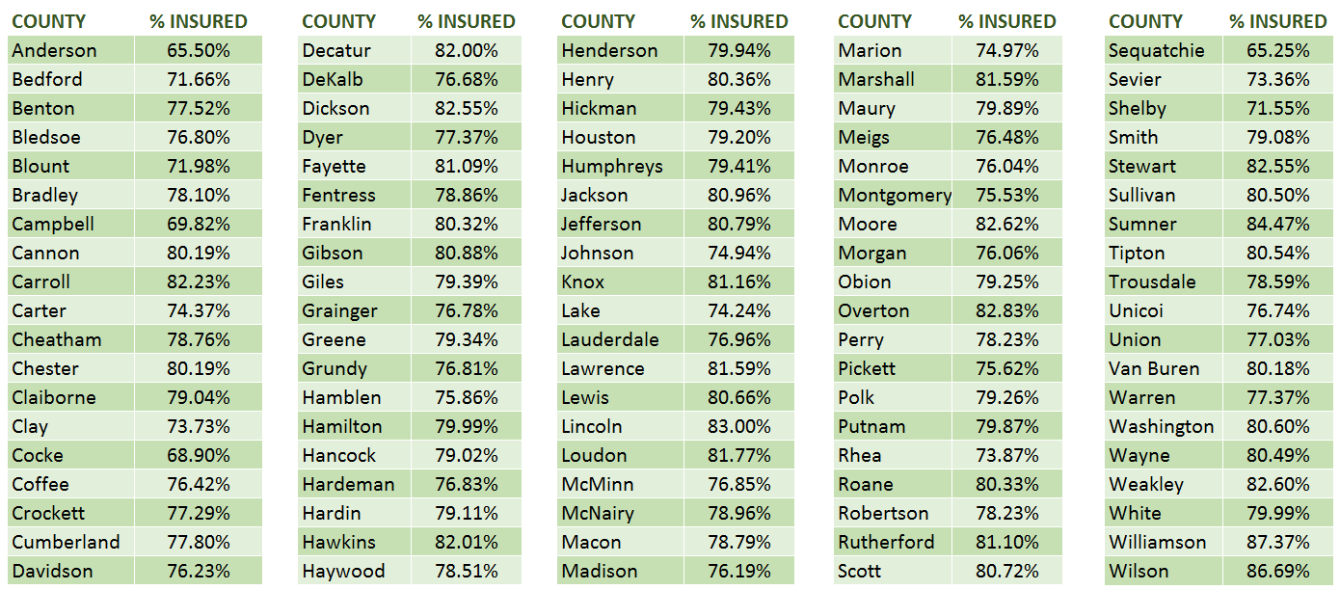
EIVS – Percent Insured By County

Slide 11
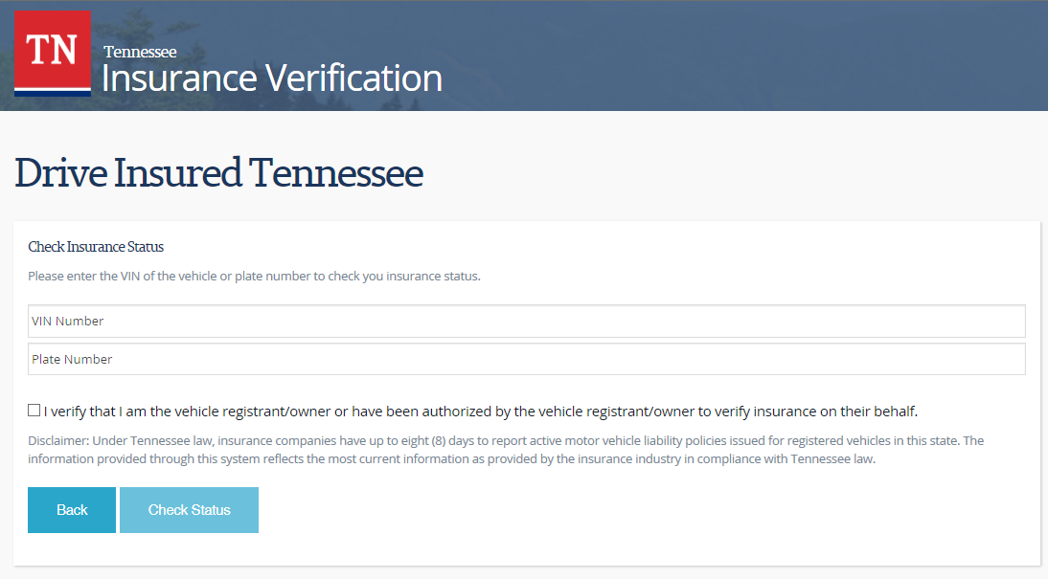
Recent Updates to EIVS
Go to www.DriveInsuredTN.com → “Respond to Your Notice/Check Insurance Status”

Slide 12
VTRS
AFTER GO-LIVE PRIORITIES
Tenn. Code Ann. § 55-4-104(c)(2) department may issue any business that registers at least fifteen thousand (15,000) vehicles annually and is engaged in the rental of motor vehicles, trucks, and trailers for periods of thirty-one (31) days or less when the vehicle is delivered to the lessee in this state registrations that are valid for twenty-four (24) months, and expire on the last day of the last month of the registration period.
This new process will allow the ability for a county to process registrations for businesses meeting certain requirements with 2 year registrations. This will double the registration fees when processing the transaction. These registrations will be flagged in VTRS for reporting purposes.
The yearly registration decal will populate a 24 month expiration date. To participate in the 24 month registration process the business must receive approval from the department.

Slide 13
LEGISLATION
VS is in the process of developing procedures and making necessary system changes, updating website, materials, forms, guides etc. with applicable changes based the following public chapters that have recently been added with regards to T&R.
DOR Official Legislative Summaries will be released soon!
PC 606 – Allows registrant to display proof of registration on a mobile device
PC 735 - Authorizes an owner or lessee of a motor vehicle who is deaf or hard of hearing to request that the department of safety include such designation in VTRS

Slide 14
LEGISLATION
SB 1474 (passed, no PC yet) - Creates a "5th Special Forces Group (Airborne)" military license plate for issuance to current or former members of the unit and spouses or children of such members
PC 359 - Removes the prohibition on the re-issuance of a plate that has been deemed obsolete, or the issuance of a plate substantially similar in appearance or content, for a period of three years beginning on the date the plate was deemed obsolete and invalid

Slide 15
LEGISLATION
PC 541 - Creates exemptions from sales tax, registration fee, and motor vehicle privilege tax, for any motor vehicle sold to a veteran or service member who has a service-connected disability and who is eligible for a United States department of veterans affairs automobile grant under the Disabled Veterans' and Servicemen's Automobile Assistance Act of 1970
SB 1479 (passed, no PC yet) - Authorizes issuance of government service license plates for vehicles leased by governmental entities

Slide 16
LEGISLATION
PC 585 - Broadens the definitions of "all-terrain vehicle" and "Class 1 off-highway vehicle" to include vehicles <2,500 pounds, and increases width from 64” to 80”
PC 691 – Authorizes surviving spouses of deceased national guard members to apply for issuance of national guard license plate
SB 0270 (passed, no PC yet) - Exempts active, volunteer firefighters and rescue squad members from payment of the regular registration fee at the time of renewal for any license plate

Slide 17
LEGISLATION
SB 2693 (passed, no PC yet) “Omnibus bill”
Authorizes new specialty plates
North Carolina State University
Rakkasans
Mountain Tough
Historic Maury
Boone Lake Association
Suicide Prevention
Domestic Violence and Sexual Assault Awareness
Lung Cancer Awareness
Methodist Le Bonheur Healthcare
Cumberland University
Paratrooper
Stand with Israel
University of South Carolina
Kiwanis International
TN Back the Blue
Down Syndrome Awareness

Slide 18
LEGISLATION
Omnibus Bill. Cont’d
Changes references from "Tennessee Fraternal Order of Police" to "Fraternal Order of Police" in the provisions governing the special license plate for the organization. Under present law, to be eligible for the plate an applicant must present a statement from the Order certifying the applicant to be a member or associate member. This amendment adds as alternative documentation a copy of an active membership card. Funds from the plates will continue to be allocated to the Tennessee Fraternal Order of Police Charitable Foundation.
Adds to the provisions for plates for honorably discharged veterans, a "Cold War Era Veteran" plate. This amendment also provides for the redesign of the Disabled Veteran plate. The redesigned plates will be issued after the existing inventory of the current plates is exhausted.
Grants additional time, until July 1, 2019, for the minimum order requirement to be met for the following plates:
  The Ohio State University; Niswonger Children's Hospital; Martin Luther King, Jr.; and Save the Bees.

Slide 19
LEGISLATION
Omnibus Bill. Cont’d
Adds a change to present law so that 50 percent of the revenue from the sale of Protecting Rivers and Clean Waters new specialty earmarked license plates will be distributed to the Harpeth Conservancy instead of the Harpeth River Watershed Association. The funds must continue to be used for restoring and protecting the ecological health of the Harpeth River and clean water in Tennessee.
Grants additional time, until July 1, 2019, for the minimum order requirement for the Mothers Against Drunk Driving special license plate to be met.
Clarifies that certain plates authorized by statute on or after July 1, 2013, are exempt from the minimum order requirements.
Authorizes a Louisiana State University new specialty earmarked plate, with proceeds allocated to the Louisiana State University Alumni Association to be used exclusively to support academic enrichment for students, including scholarships and educational opportunities for students from Tennessee.
Rearrangement of the sections in chapter 4 in title 55 of the TCA

Slide 20
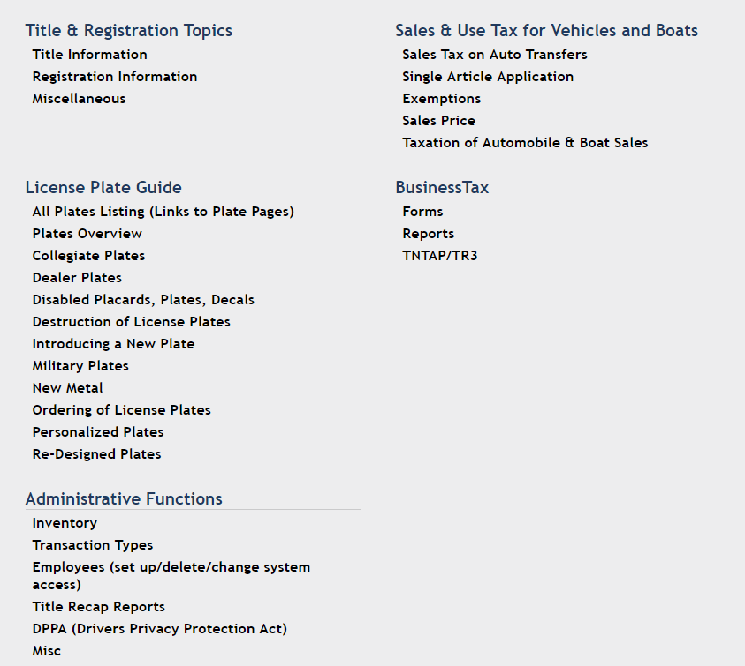
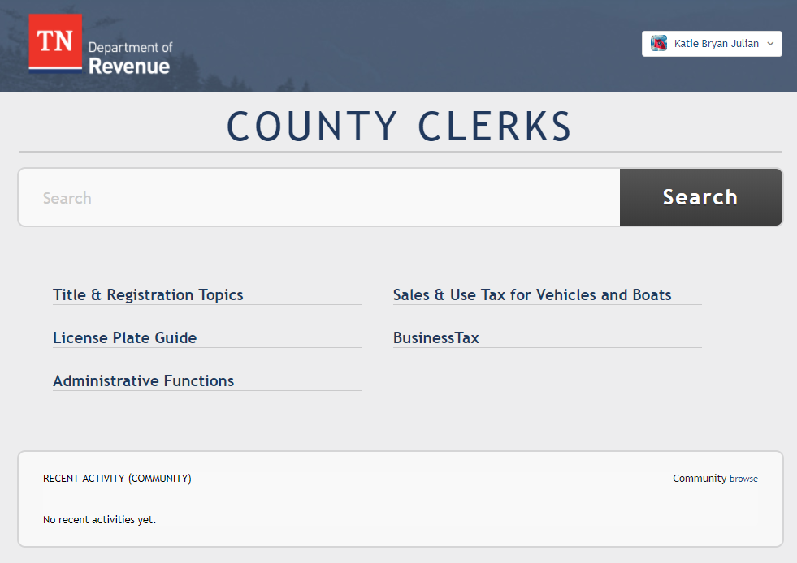
New T&R Guide – New link week of 5/21/18
The new link will replace the current link in TNClerk

Slide 21
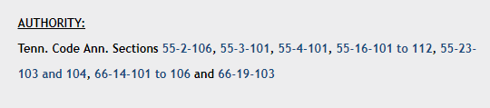
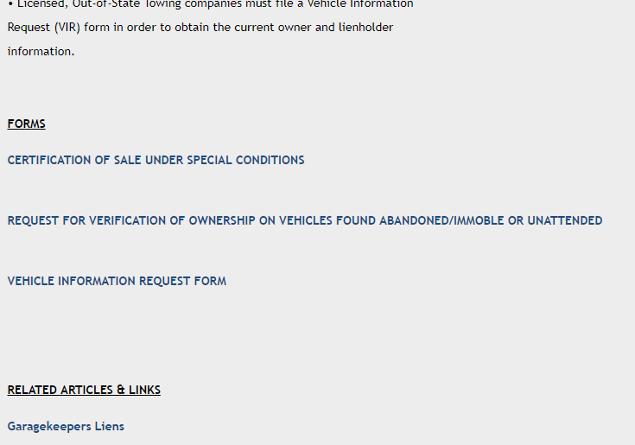


T&R Guide – Cool New Features
Direct hyperlinks to TCA, forms, and related articles
Leave comments and questions for DOR
“easy button” to ask a question

Slide 22
IMPORTANT INFORMATION – VTRS Edits
Counties can now call Vehicle Services for certain VTRS edits
send requests to CountyClerkHelp@tn.gov
or call the call center

Slide 23
IMPORTANT INFORMATION – VTRS Edits
  Examples:
  Title Status Change: County is attempting to do a transaction with the title and receives message that it is not valid and has been surrendered when it has not. VS can change the title status.
  Change Owner Name/Address/Name Code: The owner’s information is incorrect, possibly due to conversion and the title was already printed with the correct information, VS can make the edit.

Slide 24
IMPORTANT INFORMATION – VTRS Edits
  Examples, cont’d:
  Change Plate Information (plate number, expiration date, county of registration, class, issue year): County does a renewal then the state does a transaction that sets the expiration date back. VS can update the information.
  Change Former Title/State: County keys the wrong former title number/state. VS can edit the information.

Slide 25
IMPORTANT INFORMATION – VTRS Edits
  Examples, cont’d:
  Transaction Status Change: County receives “there is a pending incomplete transaction” – VS can change it from Incomplete to Complete.
  Change Vehicle Information: County keys incorrect make, model, year, color, body, odometer indicator, odometer, new/used, fuel type, vehicle type, vehicle use, gross weight, axles, class/seat, company vehicle #, purchase date.

Slide 26
IMPORTANT INFORMATION – VTRS Edits
  Examples, cont’d:
  Add Lien Holder: County adds a lien to the vehicle but it does not appear on VTRS. VS can add a lien but CANNOT remove a lien.
  VIN correction when correct VIN not already on VTRS: County keys a titling transaction incorrectly. It’s the only transaction for the incorrect VIN and the correct one is not on VTRS and the title has already been issued. VS can go in and change the VIN (not merge VINs).

Slide 27
IMPORTANT INFORMATION – VTRS Edits
  Vehicle Services can NOT make
  the following edits:
Merge existing records together (wrong and the right VINs are on VTRS with transactions under both)
Remove lienholder
Change/update title #
Pulling a record through that did not make it to VTRS.
Change title brands

Slide 28
IMPORTANT INFORMATION – e-Titles
Vehicle Services is currently studying e-Titles
Statutory changes have already been made changing the title definition to allow electronic record
E-Title = An electronic form of ownership of a vehicle
Benefits include
  Error and fraud reduction
  Streamlined process
  Green!
  Improves customer service
  Delivery time to lenders

Slide 29
IMPORTANT INFORMATION – e-Titles
STATES WITH E-TITLES
  Alabama
  Arizona
  California
  Colorado
  Florida
  Georgia
  Hawaii
  Idaho
  Iowa
  Kansas
  Louisiana
  Maryland
  Massachusetts
  Nebraska
  Nevada
  North Carolina
  Ohio
  Pennsylvania
  South Carolina
  South Dakota
  Texas
  Utah
  Virginia
  Washington
  Wisconsin

Slide 30
IMPORTANT INFORMATION – July 1 New Metal
3084/2018 – Vietnam Veteran
3665/2018 – Korean War Veteran
3670/2018 – Operation Desert Storm Veteran
3925/2018 – Operation Iraqi Freedom
3930/2018 – Operation Enduring Freedom
3931/2018 – Operation New Dawn
5508/2018 - Vietnam Veteran
5521/2018 – Korean War Veteran
5522/2018 - Operation Desert Storm Veteran
5546/2018 - Operation Iraqi Freedom
5547/2018 – Operation Enduring Freedom
5571/2018 – Operation New Dawn
These plates should arrive at county offices by the end of May.

Slide 31
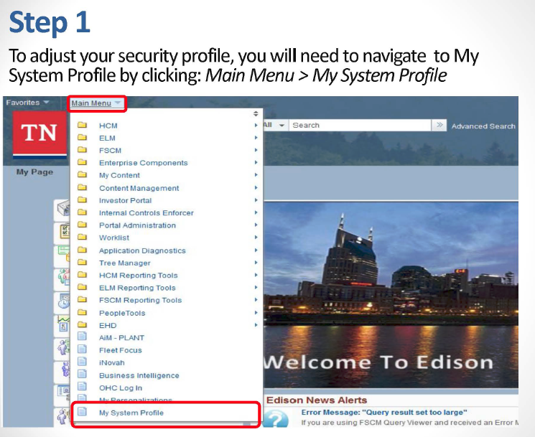
IMPORTANT INFORMATION – Edison Passwords

Slide 32
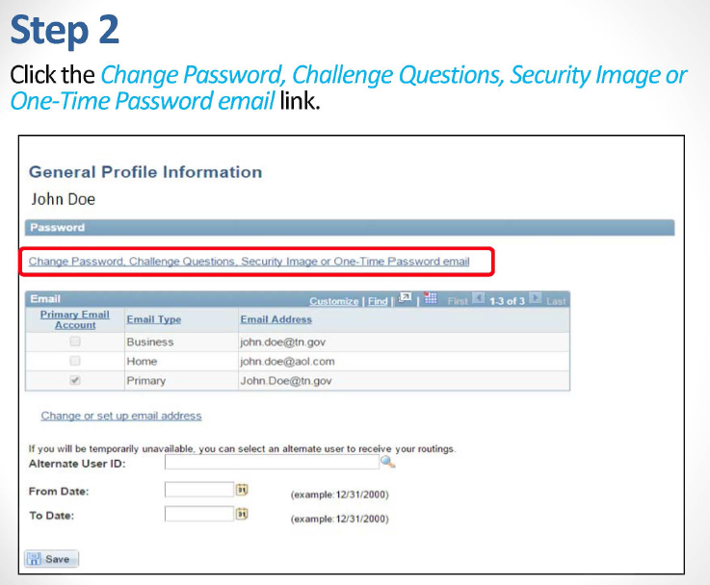
IMPORTANT INFORMATION – Edison Passwords

Slide 33
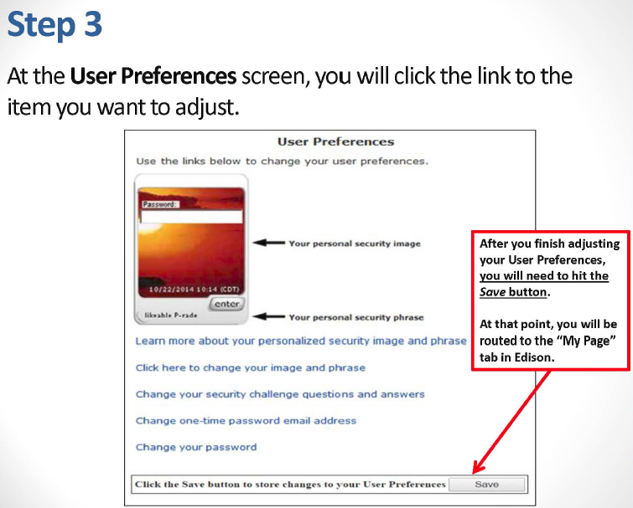
IMPORTANT INFORMATION – Edison Passwords

Slide 34
IMPORTANT INFORMATION
VS staff changes/phone list
Plate Status Issues – Phone or Email Tammie Moyers or Maria LaBoard
Add Makes – Email Tammie Moyers and Maria LaBoard
Plates
  Pat Summitt Foundation – In the latter stages of the production process
  Tennessee Titans Redesign – In the early stages of the production process
  Dealer– Ready to order
  Antique Plate – not transferrable.
Side B of emergency plate application no longer required for purchased emergency vehicles

Slide 35
QUESTIONS/COMMENTS
Thank you!!!

