Slide 1
Vehicle Services Division
Spring 2018 Regional County Clerk Meeting

Slide 2
WELCOME- Department of Revenue Updates
Legislation
TR3, VTRS and EIVS
Anti-Theft Update
www.CheckToProtect.org
IACS Visits – Audit Objectives
  Introduce County Clerk Offices to the Internal Audit and Consulting Services Section and encourage requests for assistance and/or consultation.
  Ascertain system security/access protocols are in compliance with authorized policy, procedures.
  Conduct inventory counts of plates and other controlled stock items to document initial starting inventory amounts.
  Conduct random interim HVUT compliance reviews. Test flags are in effect for certain HVUT plate classes.
  Verify fees charged are in compliance with Department mandated fee schedules.
Request for Feedback

Slide 3
VTRS
AFTER GO-LIVE PRIORITIES
  Focus on Delivery and Completion of Tasks in Priority Sequence
  Focus on Task Completion
  Focus on staying on Schedule

Slide 4
VTRS
AFTER GO-LIVE PRIORITIES
  Implement Requirements Document
  Increase the communication about tasks and focus on a manageable subset.
  9 functions are currently in development
  Report Server Delivered on 2/27- Goal Move all existing reports to State Server
  VTRS - 14 Reports (Prioritizing)
  EIVS -14 Reports (Prioritizing)
  2 Year Renewal on Enterprise Fleet
  Copart special processing

Slide 5
VTRS
SCANNING FUNCTIONS
Scanning
  Vin Plate Request (SI)
  Duplicate Salvage (SI)
  Duplicate (VS)
  U5 (VS)
  De-Title (VS)
  Returned Rejections (VS)
Scanning Government Service (VS)
  Dealer Drive Out (VS)
Scanning
  Abandoned Vehicle (VS)
  Motor Carrier Title Work (VS)
Scanning
  VIR Report Requests with Payment

Slide 6
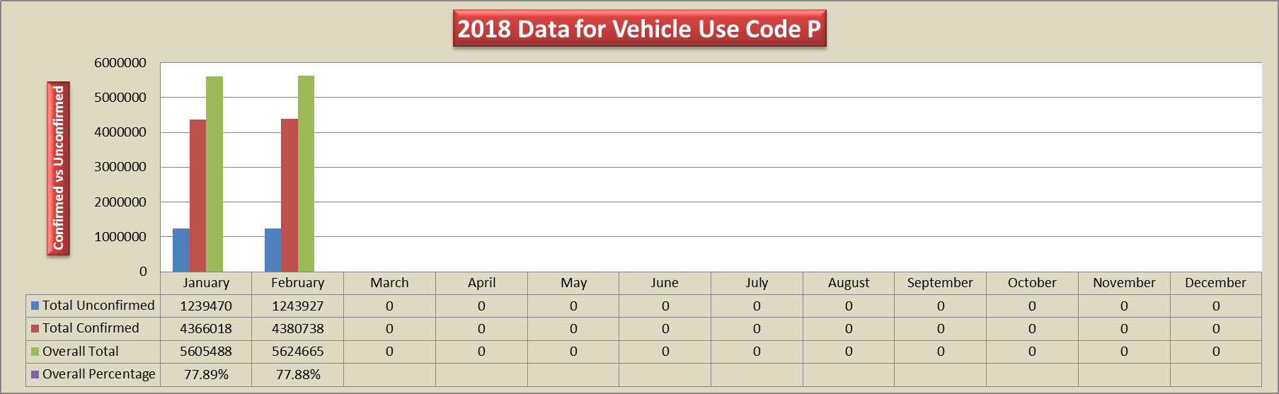
EIVS

Slide 7
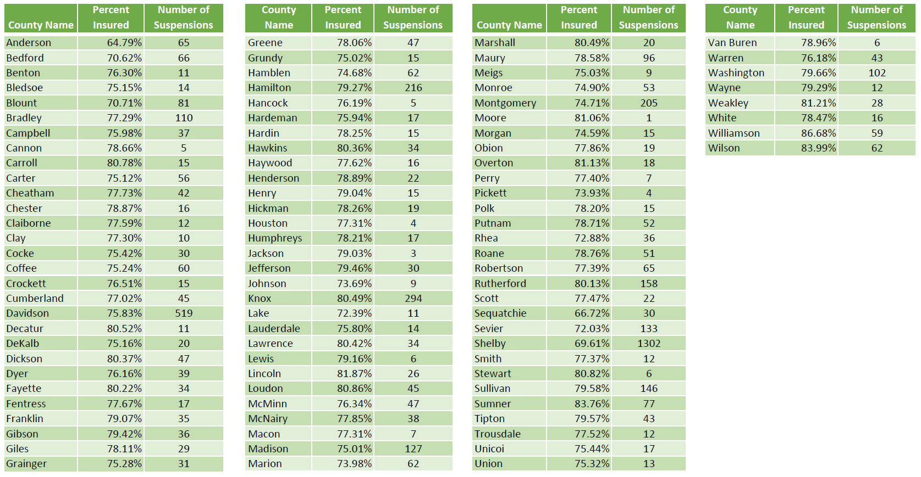
EIVS – Percent Insured & Suspension Notices by County
EIVS - County Revenue
For each $25 coverage failure fee paid, $5 will be distributed to the county clerk.
For each $100 coverage failure fee paid, $10 will be distributed to the county clerk.
When a registrant reinstates an EIVS suspension at the county clerk’s office, they must also pay a $25 reinstatement fee. The full $25 reinstatement fee goes directly to the county clerk and does not get remitted to the state

Slide 8
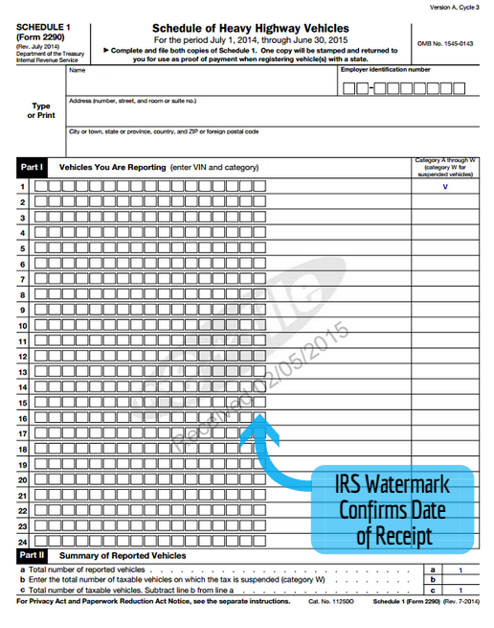
MOTOR CARRIER - HVUT
The heavy vehicle use tax or HVUT is a fee assessed annually on heavy vehicles operating on public highways at registered gross weights equal to or exceeding 55,000 pounds*.
*The system will prompt the clerk to require the HVUT for plates H8, H9, H10 and H11, but if the vehicle is less than 55,000 lbs, proof of the HVUT tax is not applicable.
As a reminder, motor vehicle registrations requiring proof of HVUT payments should not be processed until a properly executed and legibly stamped or e-filed watermarked Form 2290 is submitted.
Please review the 2290’s date range to ascertain the correct period form is being submitted at registration or renewal along with looking for the presence of white out or other alterations to the form.

Slide 9
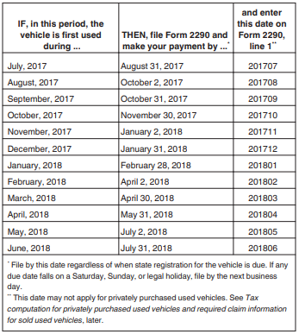
MOTOR CARRIER - HVUT

Slide 10
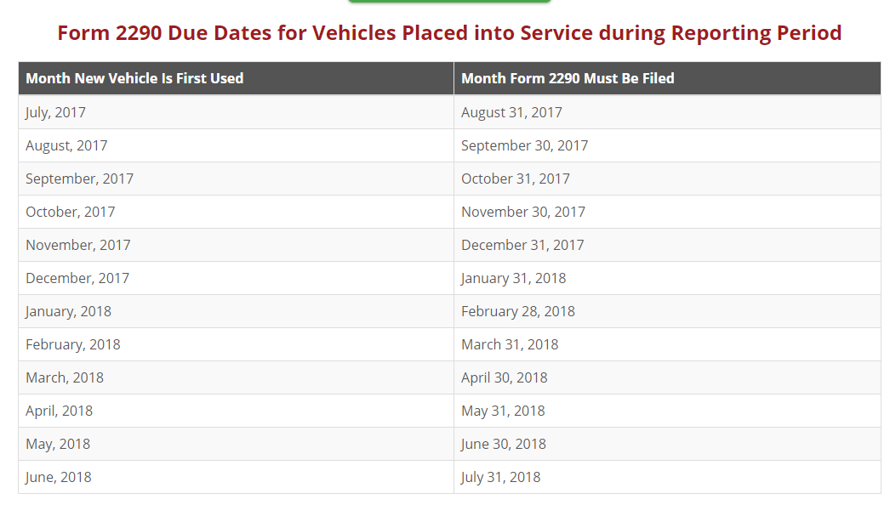
MOTOR CARRIER - HVUT

Slide 11
MOTOR CARRIER – Getting ready for TNTAP
External
Mailings to all account holders
  February letter introducing TNTAP and listing key dates
  March letter with Get-ready Checklist
  April letter detailing major changes
  May letter with step-by-step of how to log on to TNTAP
Sending notifications to account holders with missing or wrong info
Internal
  Staff training
  Open House for Motor Carrier TNTAP (3/26 at Vehicle Services)

Slide 12
Salvage/Non-repairable Process
“Salvage Title”
  If vehicle is deemed a total loss by an insurance company, the original title and registration are void
“Non-repairable”
  Owners of non-repairable vehicles can apply for a Non-repairable Certificate, which prevents the vehicle from being titled or registered in the state of Tennessee.
  Vehicle Services has been assisting Anti-Theft with keying Salvage titles- 95% of salvage titles are received from two companies. The department is working with BIS and the two companies to automate this process completely.

Slide 13
REBUILT PROCESS
There has been a change in the way Rebuilt transactions are processed. The Anti-theft (SI) Unit began processing Rebuilt Transactions through the TNState Work Grids on February 27, 2018.
Processing’s Role
  Processing processes the payment and scans the paperwork into a workgroup in TNState. Anti-theft examines the paperwork via the work grid and makes a decision on whether the transaction can be approved or not.
Anti-Theft’s Role
  In order to get the transaction out of the grid, Anti-theft rejects the transaction which produces a rejection letter that is not printed or mailed.
  SI then voids the transaction in TNState. The reason for the void is so the Counties can process their transaction when the owner comes in to title & register the vehicle and pay sales tax if applicable.
  SI sends the customer an approval letter instructing them to go into the County Clerk’s office, along with copies of the rebuilt paperwork.
County Clerk’s Role
  The County Clerk should use the approval letter and copies of the rebuilt transaction to issue a title and tags in the name of the owner. Collect sales tax if applicable and make sure the vehicle is branded rebuilt.

Slide 14
PLATES
Dealer Plates
  The dealer plates are being produced
  Several counties received dealer plates in their office yesterday
  If you have not received them yet, you can expect them within the next few days
Veteran Plates
  Public Chapter 384 passed Last year where the flags are repositioned on the following plates:
    Korean War veteran
    Operation Enduring Freedom
    Desert Storm Veteran
    Operation Iraqi Freedom
    Operation New Dawn
    Vietnam Veteran
  Vehicle Services received the final approval from Veterans Affairs to move forward with production of these plates
  Expect the plates in your office by Mid May or June 1st
  NEW METAL, not redesigned plates

Slide 15
PLATES, cont’d
In God We Trust vs Regular Green Mountain
  Customers have a choice as to which plate they prefer
March Decals
  Should be receiving them in your office any day
  A partial order has been shipped
Possible Re-Design Plates
  Penn State
  Niswonger
  Memphis Grizzlies

Slide 16
COMMUNICATIONS
Important messages from Vehicle Services will now be added to the TNClerk Viewer in addition to being sent by email
Weekly County visits
Quarterly Newsletter
Website
  New forms page
  Revenue Help
    FAQs
    Submitting “tickets”
New T&R Guide Tour

Slide 17
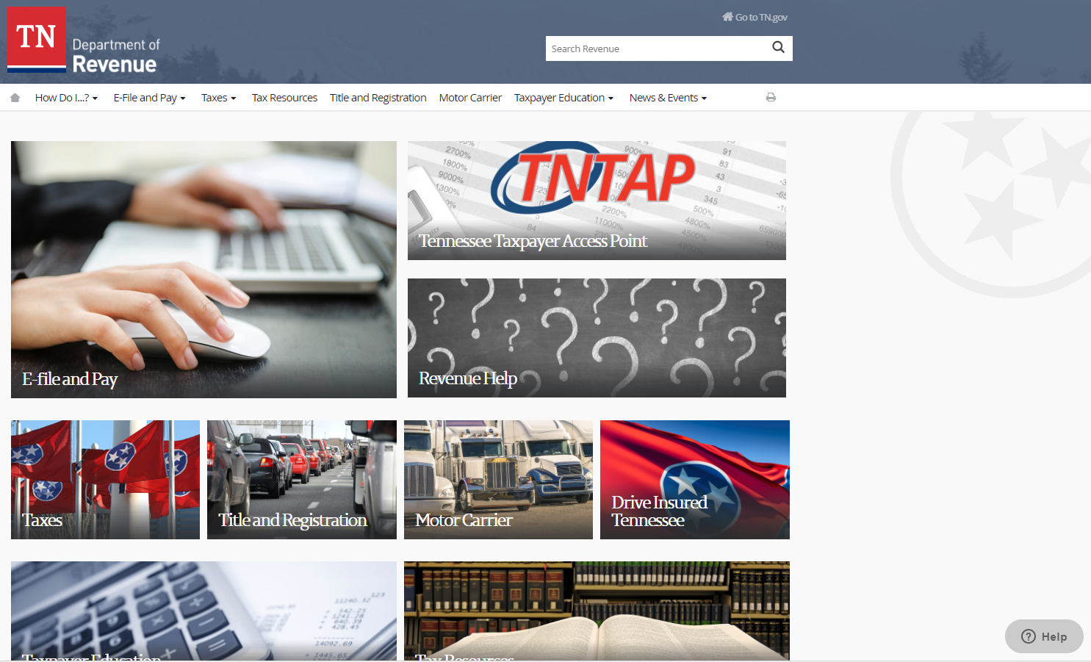
Revenue Help
www.tn.gov/Revenue

Slide 18
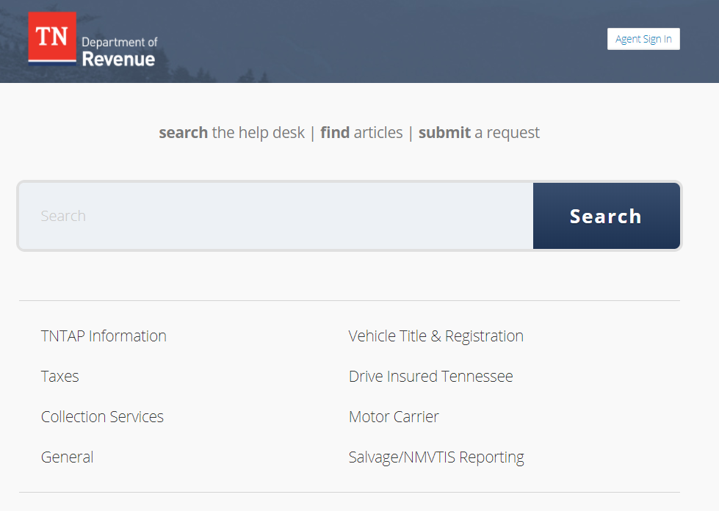
Revenue Help – Tickets
Benefits:
Quick turnaround
Communication is documented
Support staff can mark tickets according to status for easy tracking
All tickets are monitored so nothing can get “lost” in the shuffle
Reporting and metrics
TICKET STATS
Tickets per month (Veh.Svcs.)- ≈ 1.1K
Satisfaction Score - 95.3% (32% response rate)
Average response time - 0.5 hours
Email inboxes routing as tickets:
Motor.Carrier@tn.gov
Insurance.Verification@tn.gov
CountyClerk.Help@tn.gov
Email.T&R@tn.gov

Slide 19
Revenue Help – Tickets, cont’d
KUDOS!
The online help request was very useful got a response very quickly I am highly satisfied and thank you for your great service!
I wish more businesses provided customer service at this level!
Had a response in less time than I would have been on hold ad pressing option choices. Outstanding service and the resolved my issue.
We moved from California. I can promise you that the California Department of Motor Vehicles would never have assisted us as well as your agency. Thank you so much!
To say that I am satisfied would be an understatement. I have had experiences with other state's departments of revenue using email that would have been easier if I had called and sat on hold for an hour. The response was fast and super helpful.
This was probably the best experience I've ever had dealing with the government.
I wish you guys could take over the Maryland MVA.

Slide 20
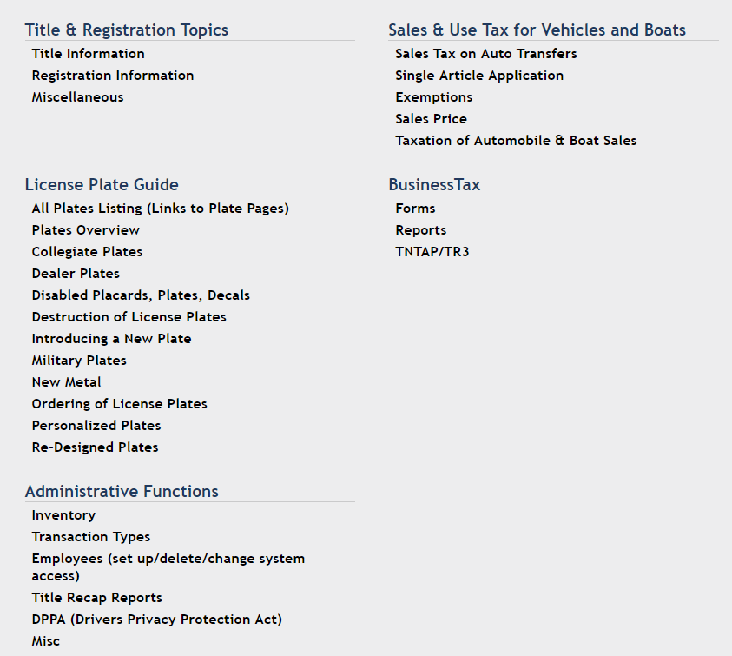
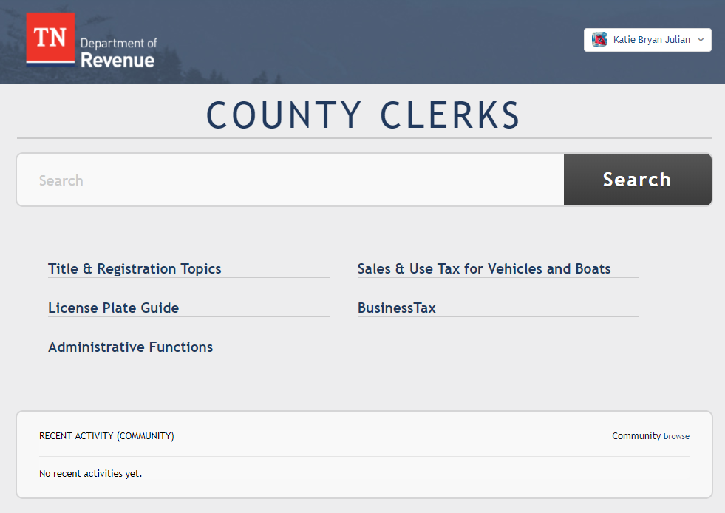
New T&R Guide – Coming Soon!

Slide 21
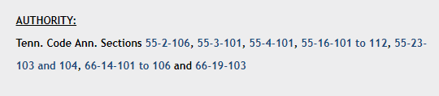
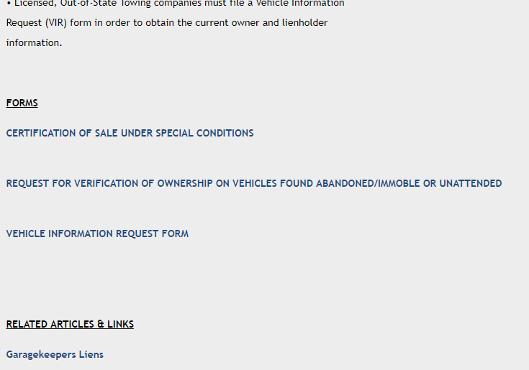


T&R Guide – Cool New Features
Direct hyperlinks to TCA, forms, and related articles
Leave comments and questions for DOR
“easy button” to ask a question

Slide 22
Vehicle Services - Updates/Reminders
Website Links – tn.gov link have changed
Vehicle Use Codes - please pay special attention to accuracy
Vehicle Make Codes - email Tammie.Moyers@tn.gov and Maria.LaBoard@tn.gov
Keying Owner Information – all characters fit, no need to use “in care of”
County Report Requests – contact BIS

Slide 23
Vehicle Services - Updates/Reminders
Question | Redesigned Plates | New Metal
plate receives new class code | yes | no
plate receives new issue year | yes | yes
customer receives new plate at renewal | no | yes
customer can switch to the new design | yes, for a $2 fee | they are forced to
customer can choose which design they want | yes (they can choose the old design if the clerk has stock) | no
clerk must destroy existing stock of old design | no, but they can if they so choose | yes
clerk may order stock of old design | no | no
organization wants to redesign their plate | yes | no
Statute requires a design change | no | yes
New Process: Redesigned Plates
The redesigned plate will receive a new class code/issue year.
Counties will place orders for the redesigned plate and will no longer be able to order stock of the old plate as production of the old stock will cease.
Counties may continue to issue the old plate until stock is depleted, but this is not a requirement.
Unless otherwise requested by a customer, when a customer requests a specialty plate they should be assigned the new redesigned version.
Customers will not automatically receive the redesigned plate at renewal time, but can request to trade in their old design for the new one upon paying a state fee of $2.00 (plus any other applicable county and/or mailing fees). The process is similar to when customers switch from the regular passenger plate (class 1000) to the In God We Trust plate (class 1001).

Slide 24
Thank you!
Questions?

