Slide 1
Vehicle Services Division
County Officials Conference 2022

Slide 2
Welcome!
  New metal issuance 2022
  Disabled license plate reissue
  Remainder of 2022

Slide 3
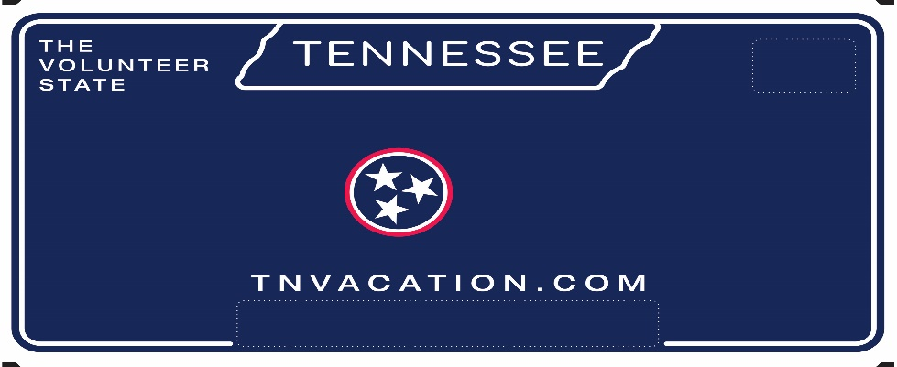

New Metal Issuance 2022
  With just two months remaining over 4,400,000 standard and In God We Trust license plates have been issued across the state!
  Thank you!

Slide 4
Disabled License Plate Reissue
Disabled License Plate Reissue:
Reissuance of disabled license plates will begin in January.
Class 1010 - Production has started on January through March renewals, and they should arrive in county offices by the end of December.
  Class 1011- January-December renewals should arrive in county offices by the end of December.
  Disabled personalized classes 2005 and 2007- January through December renewals should be in county office by the end of December.
Any Disabled personalized applied for in the month of December, 2022 will be produced on new metal.
Postcard renewal notices will be updated for January renewal notices.
A press release is planned for December.

Slide 5
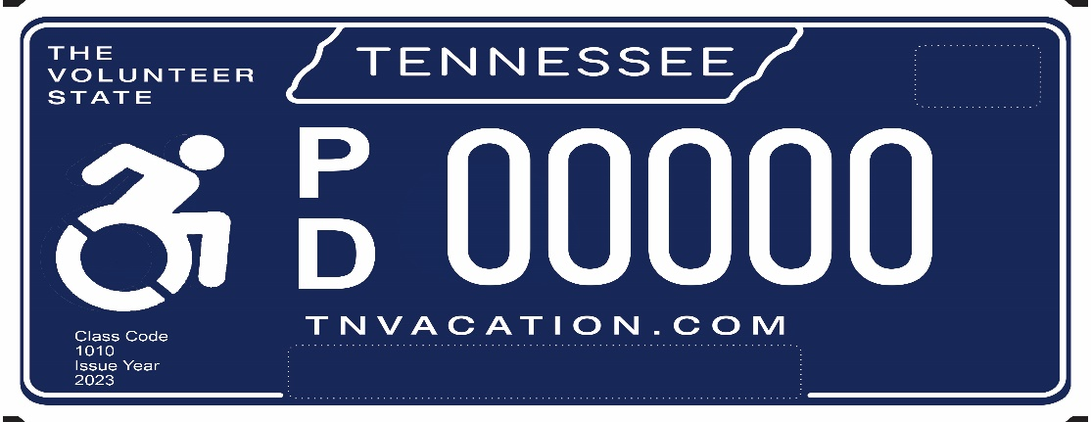
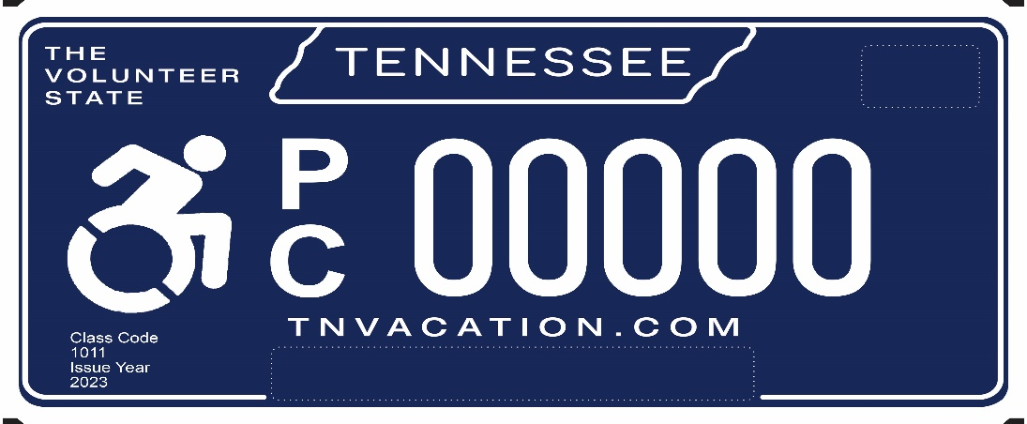
Disabled License Plate Reissue
Disabled Driver class 1010:
Disabled Driver class 1011:
Notes:
The Call Center & Research is comprised of a call center, NCIC, the National Crime Information Center, NMVTIS – National Motor Vehicle Title system and Research. The call center responds to inquiries from both the public and the 95 county clerks and can handle approximately 700 calls daily and 3,500 per week. On average, the call center handles about 14,000 calls per month. Not only are representative responsible for responding to phone calls, and they also correct title & registration issues. They can issue & correct titles and clear stops on the system when called in by the county clerk.

Slide 6
Remainder of 2022
Print on Demand Fall orders begin shipping this week.
County name decals and handicapped placards will ship in December.
TRICOR, continuing to monitor inventory on class 1000 and 1001. Production will continue 6 days a week, with TRICOR focusing on building up inventory of class 1001 and specialty plates.
Notes:
County Clerk Support bridges the gap between the State and our 95 county clerks. They inform the counties of recent legislative decisions and alert them of updates to existing forms and letters. County Clerk Support updates and edits the County Clerk Guide and the Revenue website. Additionally, they support dealers who participate in the EZ Dealer Tag program. This program allows electronic submission of paperwork related to a vehicle transaction from dealer to county clerks and provide the customer temporary tags.

Slide 7
Thank you!!!

